Slide 1
Local League Capacity Building Series:
Local League Governance
September 2022

Slide 2
Governance
What does governance actually mean?
One of the key responsibilities of a board is governance: the setting of policy. Policies are the guidelines/sets of directions that steer an organization.
They range from the small day-to-day sets of directions, like check signing and personnel policies, to the bigger policies, like gift acceptance and investment policies, to the really big, over-arching policies, such as mission, budget, strategic plan, and diversified development strategy. Nothing becomes policy until it is approved by a board.
-Laura Otten, The Nonprofit Center at La Salle University
Notes:
The state board had the pleasure of welcoming Laura Otten from the Nonprofit Center at La Salle University earlier this year for a training on governance. I thought this quote in particular really captured the concept very well. A board governs. A board is responsible for setting internal policies that dictate how an organization will operate and function. Even in an all-volunteer organization, governance is vitally important in creating and maintaining an atmosphere of professionalism and efficiency.

Slide 3
Internal Policies
Each of the three legs
Policies provide an organization with three very important things:
Effectiveness
Efficiency by allowing a board and staff/volunteers not to have to rethink every repetitive situation
Protection, by introducing the consistency that comes from applying a policy to situation after same situation, ensuring that it is handled the same way each time, regardless of the particulars.
Notes:
To be clear, when we talk about policies and governance we are talking about INTERNAL policies. At the League, we also do EXTERNAL advocacy work in an attempt to influence public policy. But when we’re talking about governance, we’re talking about the INTERNAL policies that dictate how we operate as an organization. Clear and consistent internal policies make an organization more effective in carrying out their mission, more efficient by empowering people to know what authority they have in a given situation and, most importantly, PROTECT THE ORGANIZATION by introducing consistency.

Slide 4
Governance Examples
Internal Policies ≠ External Advocacy Work
Bylaws
Nonpartisan Policy
Diversity, Equity and Inclusion Policy
Board Reimbursement Policy
Signing Authority Policy
Notes:
Some examples of what sorts of policies we’re referring to include SEE SLIDE.
By having our own internal ducks in a row, we can help avoid distractions from our mission and core work of empowering voters. You don’t want to spend hours arguing over whether or not someone is eligible to have an expense reimbursed or who is authorized to sign a contract or check or when your 990 is due. You want to spend your time registering and educating voters.

Slide 5
Handbook for Local League Leaders
Ensuring alignment between national, state & local League policies
The Local League Leaders Handbook covers all of the following areas:
Minimum Requirements for Leagues
Guidelines for Pennsylvania Leagues
Statement of Policy for Local Leagues In Pennsylvania
Per Member Payments (PMP)
Internal Revenue Service (IRS) Form 990-N
Form 990-N Information Due Dates
Pennsylvania Sales and Use Tax Guidelines
Liability Insurance
Local League Education Funds Held by LWVUS/LWVEF
LWVPA Staff & Board Contacts
Notes:
The handbook for local League leaders covers a number of core governance and operational areas. It’s a very streamlined document full of a lot of vital operational information.
I’m not going to go through every portion of the handbook. Instead, I’m going to highlight a few key areas I think are important to understanding how the League functions.

Slide 6
Minimum Requirements
Must be followed by all state and local League units
There are a set of minimum requirements which all League units on the state and local level must follow.
No local League may have bylaws or a mission statement which contradicts that of state and/or national Leagues.
Notes:
The first is pretty straightforward. In order to be a League, there are a set of minimum requirements that all units at the state and local level must follow.
No local League may have bylaws or a mission statement which contradicts that of state and/or national Leagues.

Slide 7
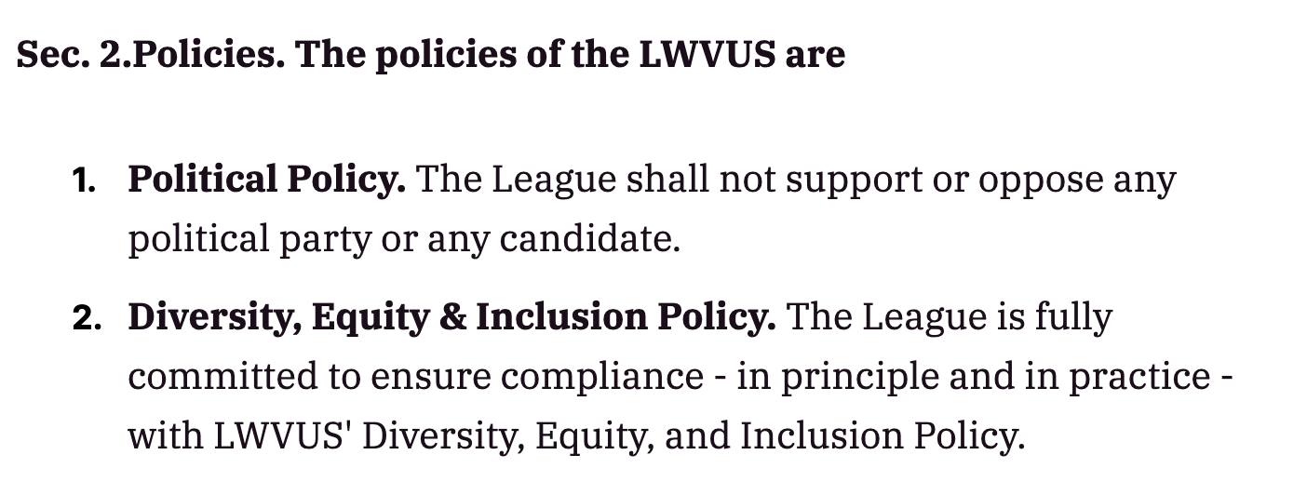
Example
Nonpartisanship & DEI
https://www.lwv.org/league-management/bylaws/bylaws-and-certificate-incorporation
Notes:
So what does this mean in practice? This is an excerpt from the LWVUS bylaws that covers nonpartisanship and DEI. We as a state league or you as local Leagues can’t turn around and decide you are going to change your bylaws to endorse a candidate or say that you are going to ignore the League’s DEI policy.

Slide 8
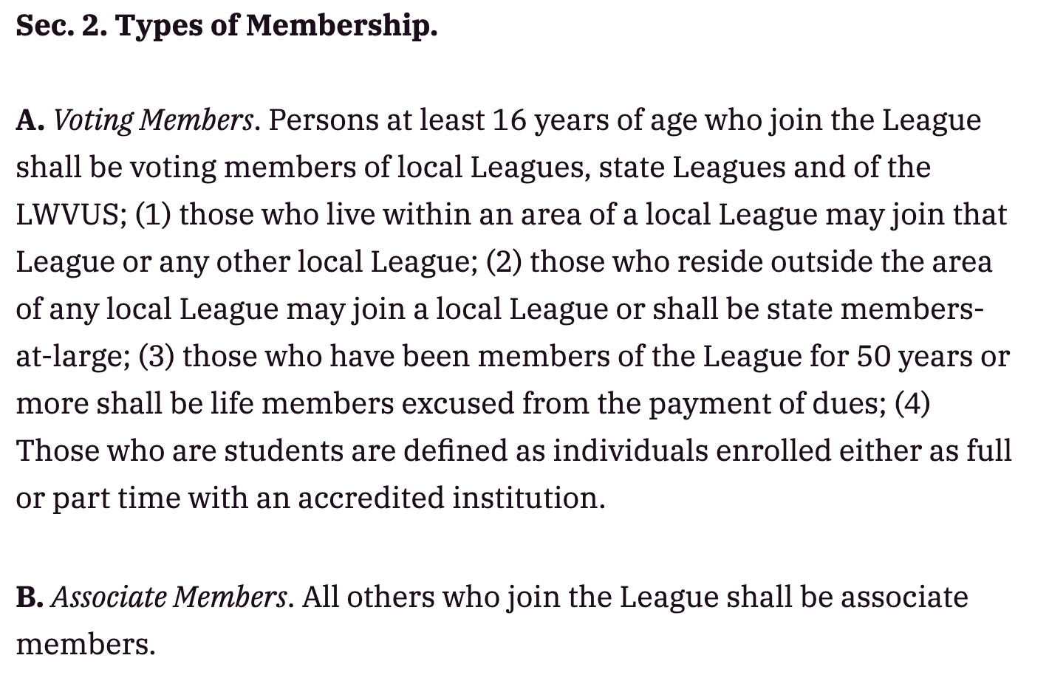
Example
Membership
https://www.lwv.org/league-management/bylaws/bylaws-and-certificate-incorporation
Notes:
Another example is membership. This is how LWVUS defines membership. If someone meets those requirements and signs up to be a League member, we as a state league and you as local leagues cannot deny them membership.
We can create additional membership categories above and beyond what is described here. For example, at the 2019 LWVPA Convention members voted to establish $35.00 per year membership for anyone 35 years of age or under. This membership category is now available for Members at Large (MAL) and for all Local Leagues in Pennsylvania to offer to their membership if they choose. This is an optional additional membership category that local leagues have the option of offering.

Slide 9
Guidelines for Pennsylvania Leagues
Recommendations to support short and long-range planning
Nominating Committee
Membership
Finance
Budget
Local Action
State and National Studies
State and National Action
Coalition Building
Election Services
Continued Communication
Meetings
Reporting Procedures
Notes:
The handbook also includes these guidelines to help support short and long-range planning for local Leagues. It covers a lot of ground, so I just want to strongly recommend you take an opportunity to read and reflect on areas where your league is strong and areas where there are opportunity for growth.

Slide 10
Per Member Payments (PMP)
2022-2023
LWVUS: $32/per individual member (+$16 for each additional household member)
LWVPA: $20/per individual member (+$10 for each additional household member)
IMPORTANT: LWVPA does not charge PMP for Life members and Student members.
Notes:
The handbook covers the current rates and process for PMP. As you all likely know, LWVUS is moving towards some big changes in how PMP works and membership is structured. I strongly support these changes and we expect them to take a lot of the administrative burden off of state and local Leagues around managing and processing membership data. HOWEVER, they aren’t pulling the rug out from under us and are implementing these changes very slowly. So for 2022-2023 we have our usual PMP formula.
Do want to flag that there are two special membership categories that local Leagues are welcome and encouraged to offer: life members and student members.

Slide 11
Finances & Insurance
990, PA Sales Tax, Liability Insurance, LWVUS Ed Fund
If your fiscal year end date does not match the IRS records, you need to mail a letter to the IRS to request a change.
LWVPA holds the Sales Tax License for the PA state organization only.
The state League has a liability policy under which local Leagues may receive Liability coverage. Payment for 2022−2023 insurance coverage will be due September 14, 2022.
League of Women Voters Education Fund (LWVEF) has a program that allows state and local Leagues that are not exempt to solicit tax-deductible donations.
Notes:
If your fiscal year end date does not match the IRS records, you need to mail a letter to the IRS to request a change. Email info@palwv.org to request more information or a sample letter.
LWVPA holds the Sales Tax License for the PA state organization only. All Local Leagues in Pennsylvania must obtain their own sales tax license if they sell any taxable items.
The state League has a liability policy under which local Leagues may receive Liability coverage. Payment for 2022−2023 insurance coverage will be due September 14, 2022.
League of Women Voters Education Fund (LWVEF) has a program that allows state and local Leagues that are not exempt to solicit tax-deductible donations. There is a link to where you can get more information in the handbook

Slide 12
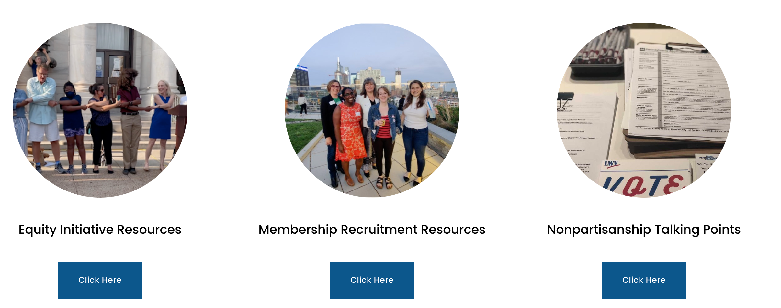
PALWV.org
Tons more resources on our website!
https://www.palwv.org/local-league-resources
Notes:
Anytime your local League is looking for resources, I urge you to start by checking out the Resources for Local Leagues section of our website!
It has:
Equity Initiative Resources
Membership Recruitment Resources
Nonpartisanship Talking Points
Committee for Support
Write a Letter to the Editor
Bylaws
Communicator
DEI policy
Nonpartisan Policy
League Operations
Starting a League
Local League Capacity Building Webinars
Voter Services Resources

Slide 13
THANK YOU!

