Slide 1
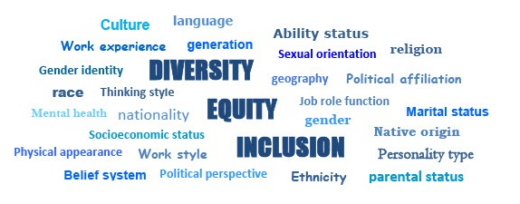
Module 1: What is DEI?
Diversity, Equity and Inclusion Learning Modules DEI

Slide 2
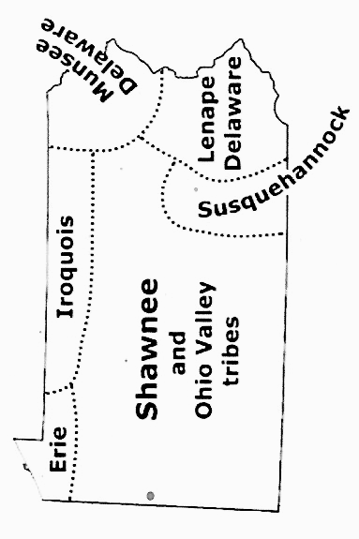
Land acknowledgement for Pennsylvania
.
Pennsylvania and Indigenous land map
DEI

Slide 3
Discussion Guidelines
Show Respect
Listen (it’s more important than speaking)
Speak to the subject at hand
We all may feel discomfort experiencing
new ideas and perspectives
Practice self-care
Not all problems will be solved now
Look for common ground
DEI

Slide 4
The LWVPA Equity Initiative, with local Leagues throughout Pennsylvania, has developed this series of five learning modules to build understanding of Diversity, Equity and Inclusion (DEI).
Welcome!
DEI Learning Module
1 of 5
DEI

Slide 5
Module 1:
What is DEI?
Why does it matter to the work of your League?
Our Purpose:
Understand the League of Women Voters policies concerning Diversity, Equity and Inclusion and how these policies can be used within your League to advance the League mission of Empowering Voters and Defending our Democracy.
DEI

Slide 6
Learning Objectives
for Module 1 - What is DEI?
Understand
Develop
Identify
the LWV DEI Policy and how diversity equity and inclusion are interconnected
an understanding of the importance of DEI in your League
ways to use the DEI Lens with your League members
DEI

Slide 7
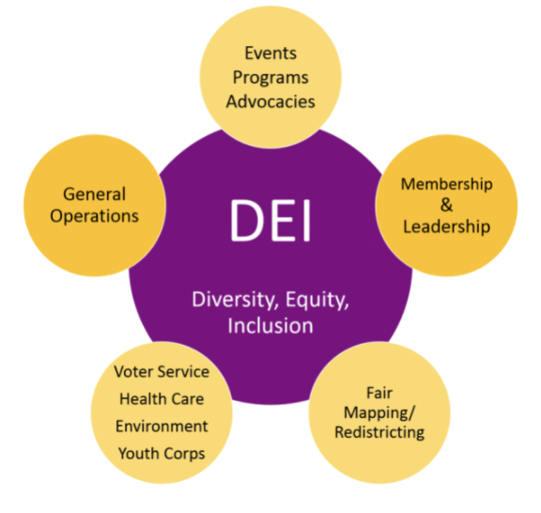
What are the essential questions
to ask about DEI?
What is diversity, equity,
and Inclusion (DEI)?
What is a League community?
Why is DEI important to your League and your community?
DEI

Slide 8
What are the essential questions
to ask about DEI?
How are diversity, equity, and inclusion interconnected?
What are some ways to
advance the DEI policy
In your League?

Slide 9
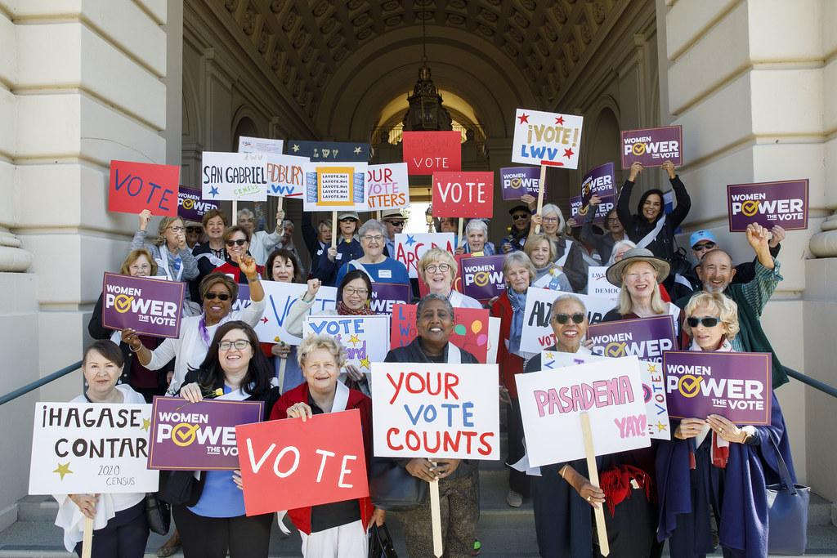
As a LWV Member Be a DEI Leader

Slide 10
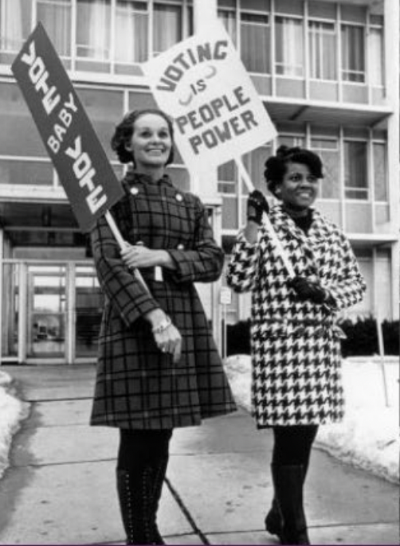
DEI, a definition:
Programs and policies encouraging a
culture of belonging and welcoming.
Welcoming marginalized groups,
identities, and individuals.
Capacity for organizational change
Diversity, equity and Inclusion are
separate and interdependent.
DEI practices work synergistically to
benefit the organization and members.
Equity, and Inclusion Definitions and LWVUS Glossary of Terms
DEI

Slide 11
Review & Discuss the LWV DEI Policy
LWV is an organization fully committed to diversity, equity, and inclusion in principle and in practice. Diversity, equity, and inclusion are central to the organization’s current and future success in engaging all individuals, households, communities, and policy
makers in creating a more perfect democracy.
There shall be no barriers to full participation in this organization on the basis of gender, gender identity, ethnicity, race, native or indigenous origin, age, generation, sexual orientation, culture, religion, belief system, martial status, parental status, socioeconomic status, language, accent, ability status, mental health, educational level or background, geography, nationality, work style, work experience, job role function, thinking style, personality type, physical appearance, political perspective or affliation and/or any other characteristic that can be identified as recognizing or illustrating diversity.
DEI

Slide 12
LWVUS DEI Policy Webinar
Understanding the DEI Policy
Webinar Presenters:
Melissa Currence - LWVUS Bylaws Chair - Explains bylaw procedures and DEI Policy Bylaw
Toni Zimmer LWVUS DEI Chair - Explains the DEI Policy
Watch 2 Segments of the video HERE:
@1 min 10 sec LWV DEI Policy in LWVUS Bylaws in Article II Purposes and Policies - Section 2 Policies 2
And @10 min 46 sec “Crafting a DEI Policy”
DEI

Slide 13
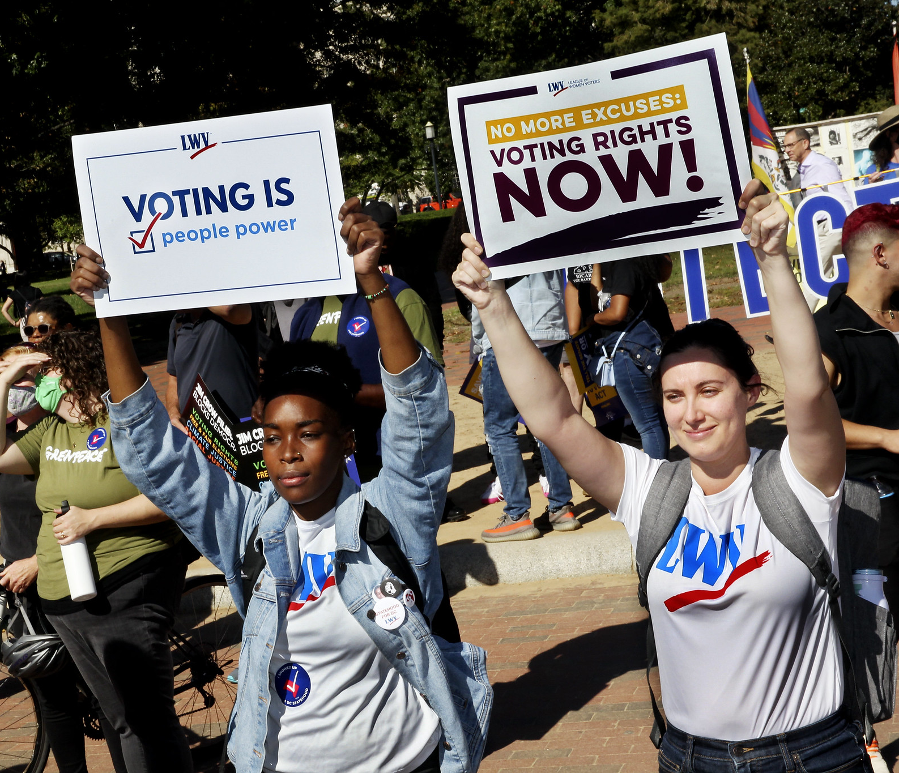
Characteristics of Diversity
Intersectionality
The interaction between different aspects of our identities
How people experience advantages or disadvantages in society depends on their identities
Our identities—race, class, sexuality, age—form our experiences, and we each experience living in society differently.

Slide 14
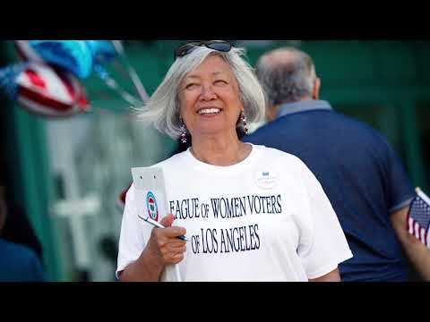
The League of Women Voters:
Creating a more
Perfect Democracy
Activity:
Watch this Video and discuss what aspects of it relate
to diversity,
equity, and inclusion.

Slide 15
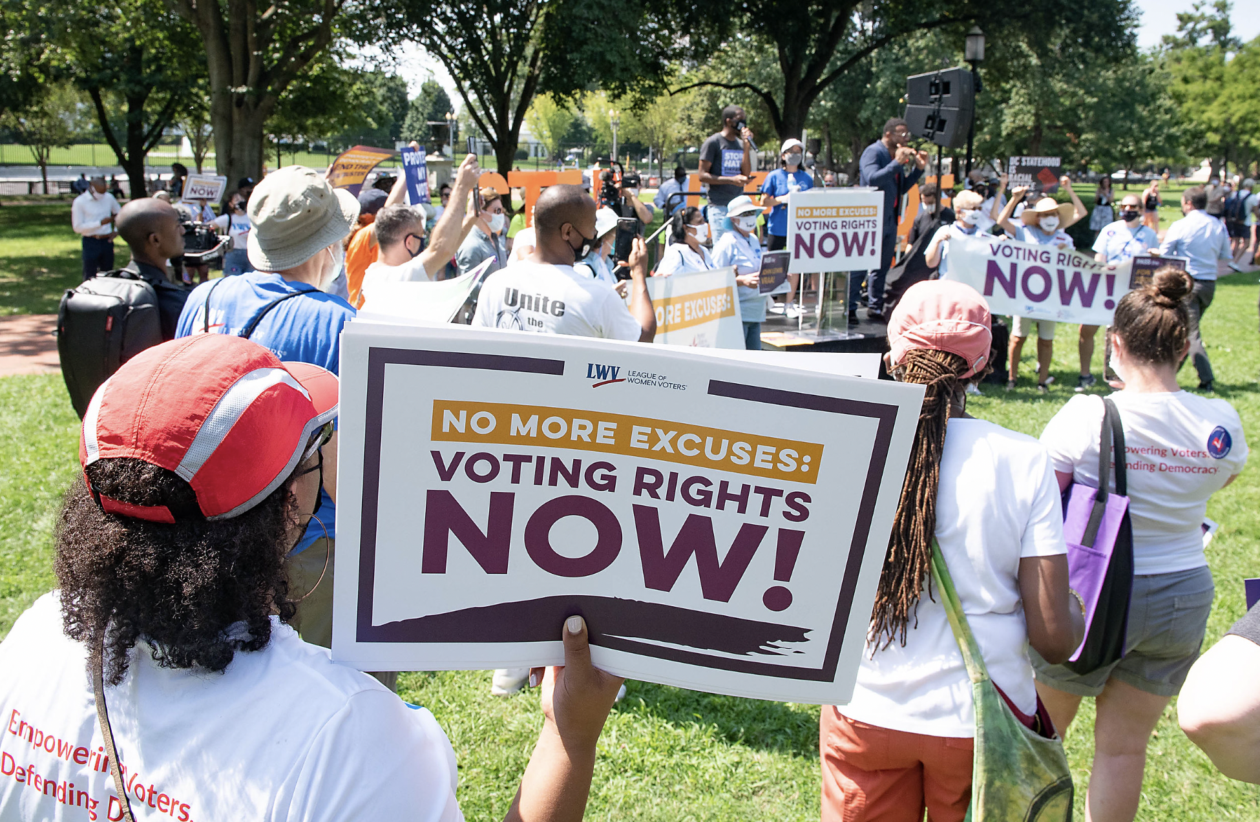
Introducing the DEI Lens
The DEI Lens is a tool for examining a program,
a process, or plan. with regards to its impact on stakeholders, on how it is perceived by diverse perspectives, and what barriers may exist to it being equitable or inclusive of everyone.
Review: What to Ask
When Examining Your Work
Through a DEI Lens

Slide 16
Introducing the LWV
DEI Lens
Think of an upcoming event. Examine it
using the questions posed under four
key categories.
Who is involved in
the process?
Who will be impacted?
What are the intended and unintended outcomes?
Does this align with our vision for an equitable and inclusive organization?

Slide 17
DEI Vision
We imagine a League that:
Embraces and embodies diversity, equity, and inclusion as inextricable from the mission to empower voters and defend democracy.
Engages in purposeful action to advance diversity, equity, and inclusion beyond words.
Commits at the individual and collective level to bring more self-awareness and understanding of diverse perspectives and experiences.
Is known for being relevant, diverse, equitable, and inclusive, inside and out.

Slide 18
Evaluate Your League DEI Efforts
Evaluate your League's commitment to sharing the DEI policy and principles with your members.
Has your League adopted the DEI policy? Y/N
Is the DEI policy on your website? Y/N
Has the DEI policy been shared with your members? Y/N
Have you included DEI in your bylaws?* Y/N
How does your League see DEI as being central to the organization's current and future success?
What barriers, if any, could be an issue for your
League’s commitment to DEI?

Slide 19
References and Additional Resources
DEI Basics - LWVUS DEI Intro Guide
LWVUS - DEI Management Site
LWVUS - Sample Bylaws Template
LWVUS - DEI Lens & League Work
Webinars - LWVUS DEI Webinars
LWVPA - Equity Initiative
LWVPA - Equity Shared Resources
LWVUS - Transformation Roadmap
Webinar: Understanding the DEI Policy
Webinar: Whys and What of DEI
Webinar: DEI Lens and Governance

