Slide 1
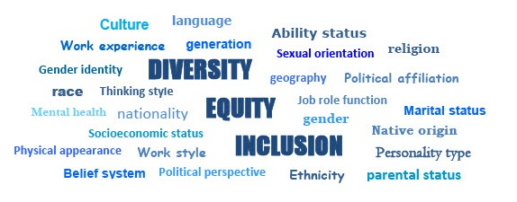
Module 2: What is Diversity?
Diversity, Equity and Inclusion Learning Modules 2022

Slide 2
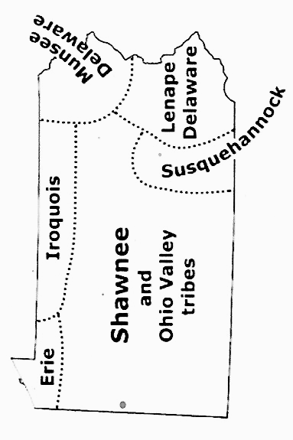
Land acknowledgement for Pennsylvania
.
Pennsylvania and Indigenous land map
DEI

Slide 3
Discussion Guidelines
Show Respect
Listen (it’s more important than speaking)
Speak to the subject at hand
We all may feel discomfort experiencing
new ideas and perspectives
Practice self-care
Not all problems will be solved now
Look for common ground
DEI

Slide 4
The LWVPA Equity Initiative, with local Leagues throughout Pennsylvania, has developed this series of five learning modules to build understanding of Diversity, Equity and Inclusion (DEI).
Welcome!
DEI Learning Module
2 of 5, Diversity
!
DEI

Slide 5
Module 2:
What is Diversity?
Why does it matter to the work of the
League?
‘‘Diversity, equity, and inclusion are central to the organization’s current and future success in engaging all individuals, households, communities, and policy makers in creating a more perfect democracy.’’
LWVUS DEI Policy
DEI

Slide 6
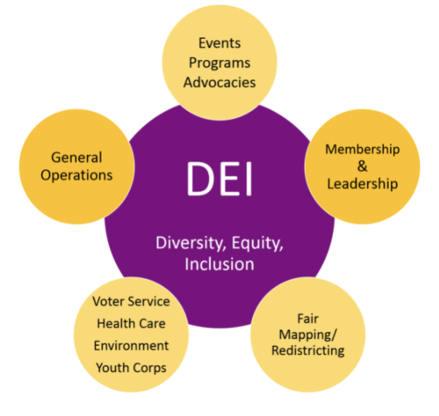
What are the essential questions
to ask about DEI?
What is diversity, equity,
and Inclusion (DEI)?
What is a League community?
Why is DEI important to your League and your community?
DEI

Slide 7
What are the essential questions
to ask about DEI?
How are diversity, equity, and inclusion interconnected?
What are some ways to
advance the DEI policy
In your League?
DEI

Slide 8
Module 2 Learning Objectives: What is Diversity?
Understand
Analyyze
Plan to advance
DIVERSITY
DIVERSITY
within your
League Community
and foster DIVERSITY
within your
League Community
Understand
and appreciate
the importance of DIVERSITY
DEI

Slide 9
What is Diversity?
Population groups that have
been historically underrepresented in socially, politically, or in economically powerful institutions and organizations.
Being conscious of the different constituent groups in your League’s community area will make your League more effective in its education and advocacy efforts.
DEI

Slide 10
What is Diversity?
All ways people differ.
All characteristics that make one individual or group different from another.
Diversity includes everyone.
Being diverse recognizes that everyone and every group will be fully valued.
DEI

Slide 11
Why Incorporate Diversity?
Building Diversity
Brings new talents, experiences & skill sets
Fosters creative solutions & problem solving
Connects to diverse constituents in community
Boosts a perception of being welcoming & socially-responsible.
Adapted from 10 Benefits of Diversity in the Workplace
DEI

Slide 12
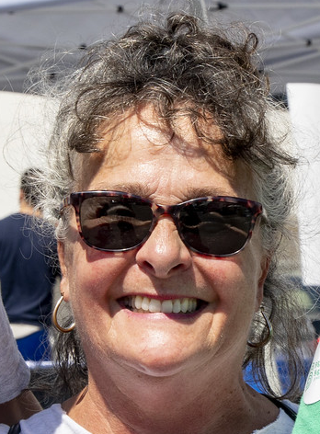
An Individual person Is NOT diverse
• A person is unique, complex, multifaceted, human with individual characteristics.
• An individual may bring diversity to your
team, but they are not “diverse”
DEI

Slide 13
LWV DEI Policy second paragraph:
There shall be no barriers to full participation in this organization on the basis of: gender, gender identity, ethnicity, race, native or indigenous origin, age, generation, sexual orientation, culture, religion, belief system, marital status, parental status, socioeconomic status, language, accent, ability status, mental health, educational level or background, geography, nationality, work style, work experience, job role function, thinking style, personality type, physical appearance, political perspective or affiliation and/or any other characteristic that can be identified as recognizing or illustrating diversity.
DEI

Slide 14
How do you describe yourself?
ACTIVITY: Use 5 or more characteristics to DESCRIBE YOU. Choose from gender, gender identity, ethnicity, race, native or indigenous origin, age, generation, sexual orientation, culture, religion, belief system, marital status, parental status, socioeconomic status, language, accent, ability status, mental health, educational level, geography, nationality, work style, work experience, job role function, thinking style, personality type, physical appearance, political perspective or affiliation,
or any other characteristic that can be identified as recognizing or illustrating diversity.
DEI
Notes:
Adapted from LWVUS “Characteristics Exercise” https://www.lwv.org/sites/default/files/2019-04/characteristicsexercise_0.pdf

Slide 15
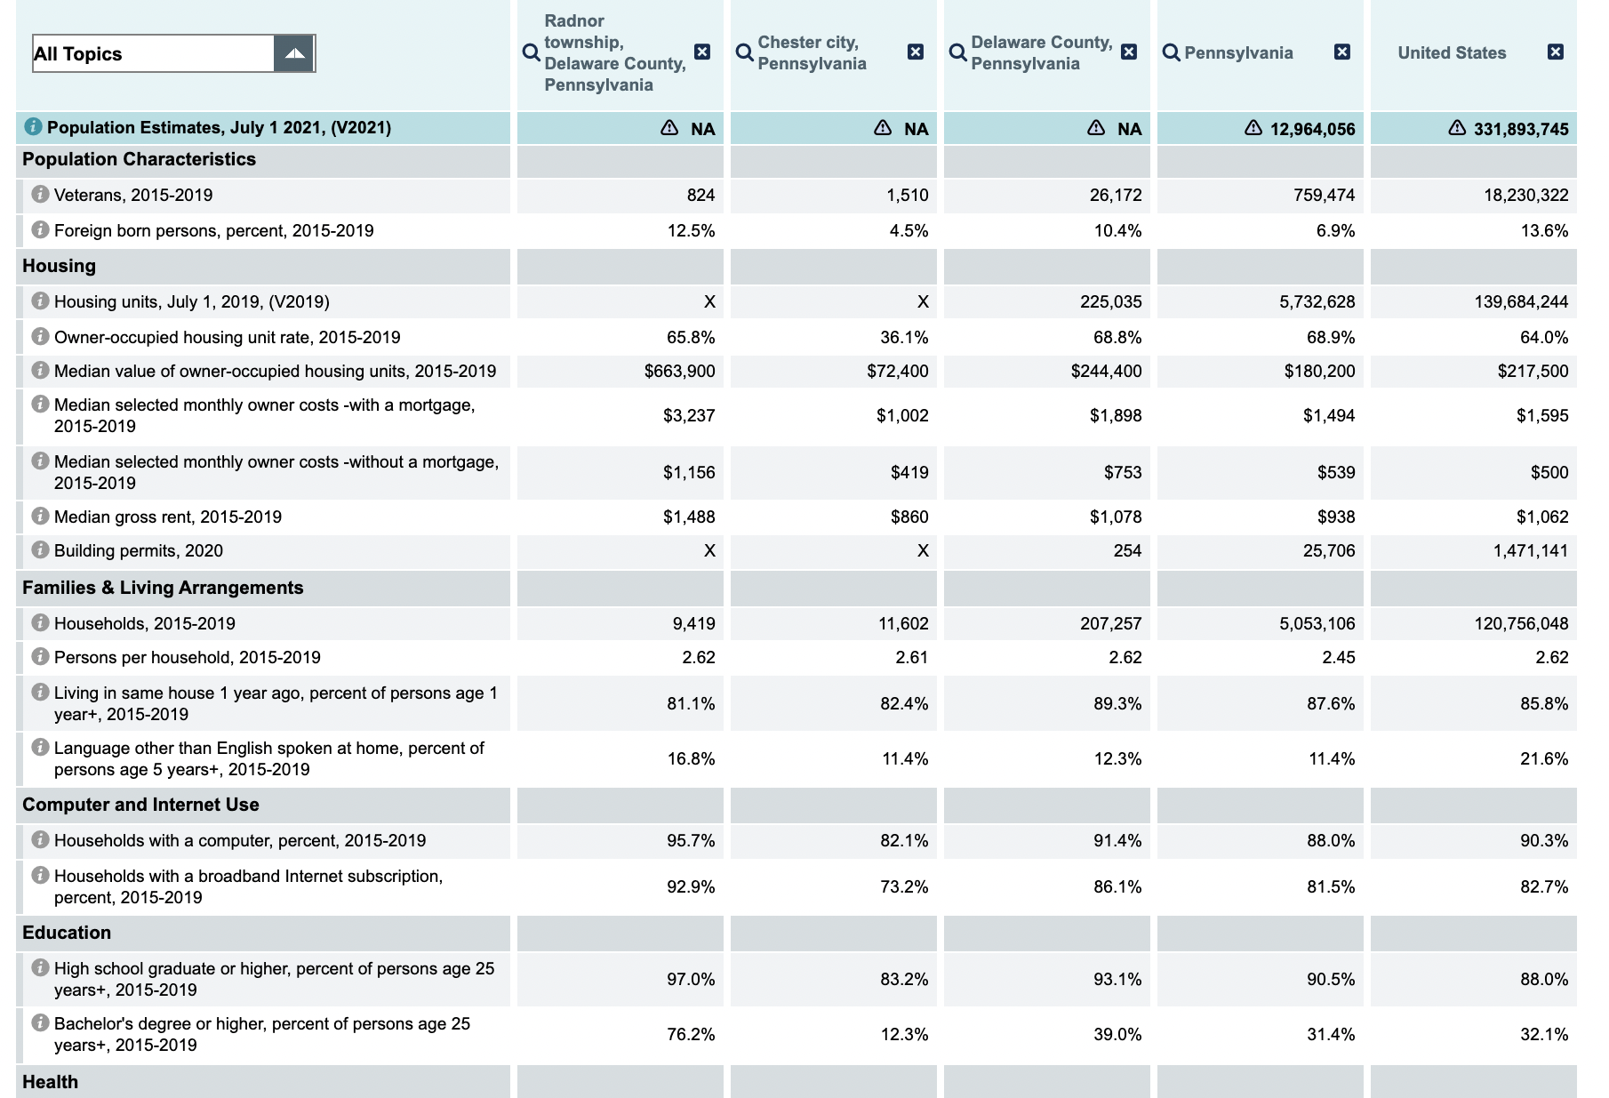
Exploring diversity around you:
ACTIVITY 1: Learn to extract diversity information from the US Census Bureau for your League Community.
You will use this information for DEI decision-making.
First, this video tutorial will explain how to use the US Census Bureau site to gather demographic information.
DEI

Slide 16
Exploring diversity around you:
ACTIVITY 2: Visit the US Census Bureau site to download information about your League’s communities.
Use this information for
DEI decision-making.
Now go to the US Census Bureau QuickFacts to get started gathering information.
DEI

Slide 17
Exploring diversity around you:
ACTIVITY 3:
Which communities and groups are within your League Community? Why are they important?
How will developing connections affect LWV membership, activities and advocacy?
Download The Sample Worksheet:
DEI

Slide 18
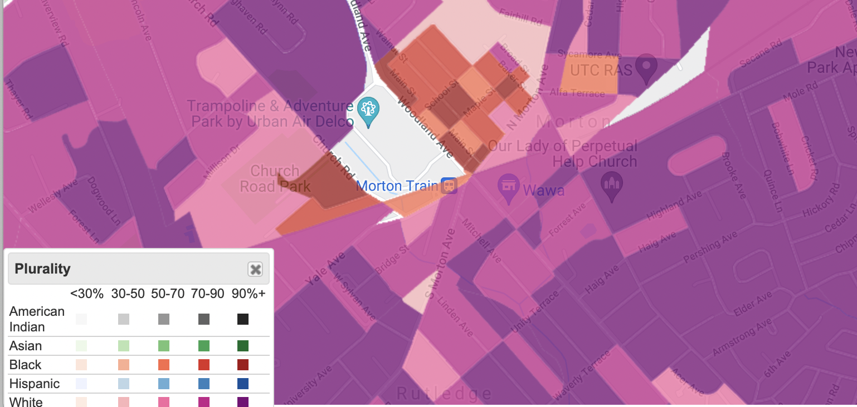
Know your League Community.
JUSTICE MAP
ACTIVITY 4: Meet neighborhoods yourself. Know the resources, schools, housing, the environment. Walk, drive, and experience.
Photo: Sai De Silva on Unsplash
DEI

Slide 19
THANK YOU!

Slide 20
What is your Diversity Mantra?
Achieving inclusive diversity means that everyone and every group - as part of a whole, throughout an organization - are equally valued.
Before you make any decision, always ask:
Who is involved in and impacted by this?
Have we included these stakeholders?
Rely on the LWV DEI Lens to guide planning.
DEI

Slide 21
References and Additional Resources
LWVPA DEI Definitions: Diversity, Equity, Inclusion
DEI Lens What to ask when examining your League work
LWVUS Transformation Roadmap
LWVPA Equity Initiative Online Resources
10 Benefits of Diversity in the Workplace
Characteristics Exercise from LWVUS - Download here.
US Census Bureau QuickFacts - Compare Diversity & Demographic Data
Tutorial About Using QuickFacts - Video Tutorial
Justice Map from the US Census Bureau: Justice Map

