Slide 1
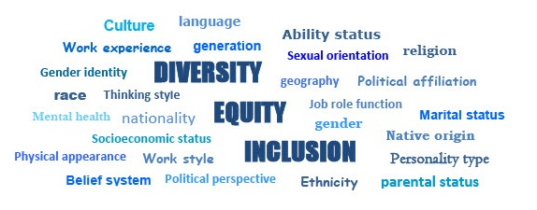
Module 3: What is Equity?
Diversity, Equity and Inclusion Learning Modules 2022

Slide 2
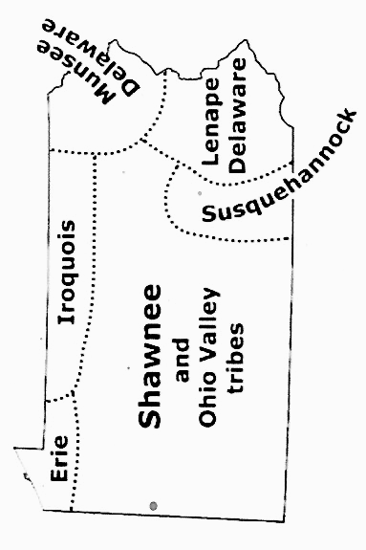
Land acknowledgement for Pennsylvania
.
Pennsylvania and Indigenous land map
DEI

Slide 3
Discussion Guidelines
Show Respect
Listen (it’s more important than speaking)
Speak to the subject at hand
We all may feel discomfort experiencing
new ideas and perspectives
Practice self-care
Not all problems will be solved now
Look for common ground
DEI

Slide 4
The LWVPA Equity Initiative, with local Leagues throughout Pennsylvania, has developed this series of five learning modules to build understanding of Diversity, Equity and Inclusion (DEI).
Welcome!
DEI Learning Module
3 of 5, Equity
DEI

Slide 5
Our shared LWV DEI Vision
We imagine a League that:
Embraces and embodies diversity, equity, and inclusion
as inextricable from the mission to empower voters
and defend democracy.
Engages in purposeful action to advance diversity, equity,
and inclusion beyond words.
Commits at the individual and collective level to being more self-aware and understanding of diverse perspectives and experiences.
Is known for being relevant, diverse, equitable and inclusive - inside and out.

Slide 6
Module 3:
What is Equity?
Why does it matter to the work of your League?
Our Purpose:
Understand the League of Women Voters commitment to building Equity in all LWV work.
Equity refers to systems, processes, and approaches based in fairness that ensure everyone is given equal opportunity and treated with dignity and respect.
DEI

Slide 7
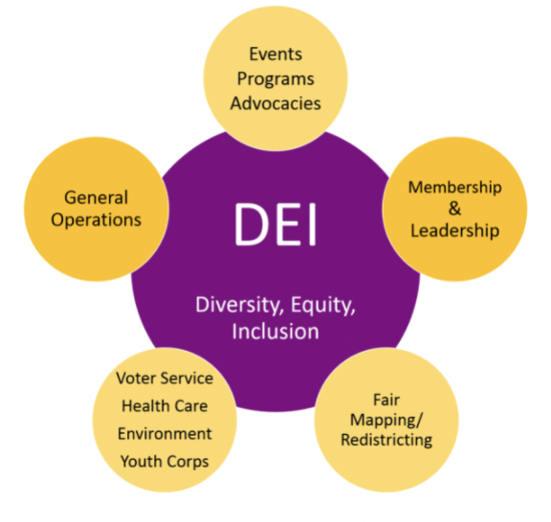
What are the essential questions
to ask about DEI?
What is diversity, equity,
and Inclusion (DEI)?
What is a League community?
Why is DEI important to your League and your community?
DEI

Slide 8
What are the essential questions
to ask about DEI?
How are diversity, equity, and inclusion interconnected?
What are some ways to
advance the DEI policy
In your League?

Slide 9
Learning Objectives
for Module 1 - What is Equity?
Understand
Understand
Understand
Equity ensures everyone is given equal access to resources and are treated with dignity and respect.
Resources may be divided and shared differently so each person has a fair chance to succeed.
The difference between equity
and equality.
Sources: LWVUS and LWVPA
DEI

Slide 10
Equity vs Equality:
Fair isn’t always Equal
A book about assessment for educators is titled “Fair Isn’t Always Equal” …
Q: What do you think the author means by this title?
2018. Rick Wormeli. Fair Isn't Always Equal, 2nd ed.: Assessment & Grading in the Differentiated Classroom. Stenhouse Publishers.

Slide 11
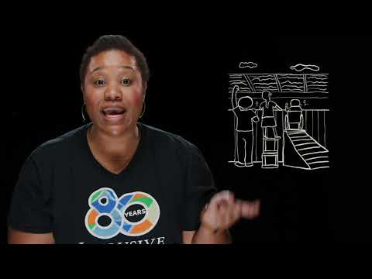
Differences between equity and equality
WATCH
THE VIDEO: “Equity vs. Equality”
Source: Inclusive Communities
Fred C. Beyer High School
Modesto, CA
April 23, 2020

Slide 12
What is Equity? What is Equality?
EQUITY
EQUALITY
Why is there more resistance to equity than equality?
What is needed to provide equitable opportunities for those marginalized or historically depicted as “less than”?
How does the sharing of stories help find solutions?

Slide 13
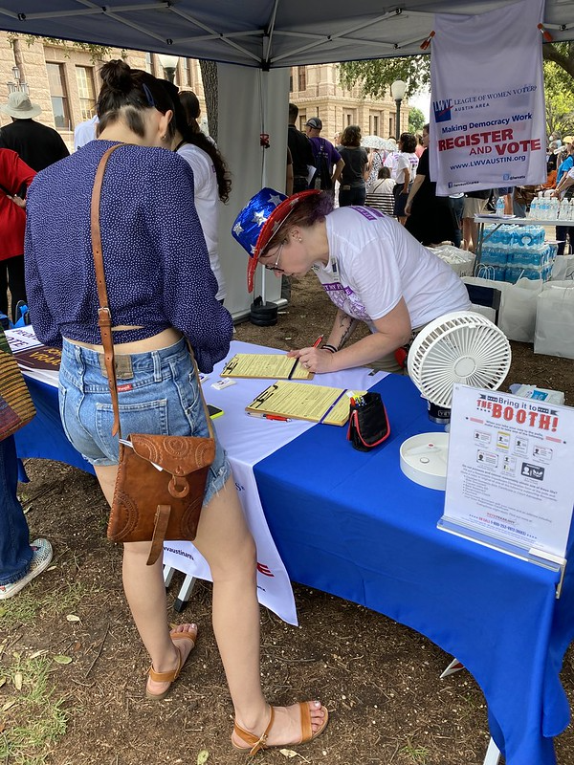
Equity in League Communities
Equity and equality in real life
ACTIVITY: identify how equity and equality show up in 4 different scenarios.
What is at play…. Equity, Equality, or both?
DEI

Slide 14
Equity, Equality or both?
Research has found that drugs such as antihistamines and antibiotics may cause different reactions and side effects in females and males. In order to ensure that drugs do not cause harm to either sex, new guidelines recommend that all clinical trials of medications involve both women and men.
1
DEI

Slide 15
Equity, Equality or both?
A local hockey camp for children teaches skating and stickhandling skills before the hockey season begins. In the past, primarily children from affluent, predominately white schools have attended the camp, but organizers are taking steps to recruit campers from less affluent schools. These schools, racially and culturally diverse, are predominantly nonwhite. Hockey teams from poorer schools have less access to team training to develop key hockey skills.
2
DEI

Slide 16
Equity, Equality or both?
A community decides to open a library in a low-income neighborhood.
3
DEI

Slide 17
Equity, Equality or both?
A city council creates a policy requiring that all new housing developments include recreation centers. The policy is designed to increase opportunities for physical activity, which may contribute to better health in general for members of these communities.
4
DEI

Slide 18
Equity from a League of Women Voters perspective.
Where in League work
is equity an issue?
What are the implications of addressing equity within our local Leagues?
What will we do differently?

Slide 19
The League of Women Voters believes:
Equity is an approach based in fairness, ensuring everyone is given equal opportunity. This means that resources may be divided and shared unequally to make sure each person has a fair chance to succeed.
Equity acknowledges that people have different access to resources because of systems of oppression and privilege.
Equity seeks to balance that disparity.
(Slide 1 of 3)

Slide 20
The League of Women Voters believes:
Improving equity involves increasing justice and fairness within the procedures and processes of institutions or systems, as well as in their distribution of resources, including professional growth opportunities.
Tackling equity issues requires an understanding of the root causes of outcome disparities within our society.
(Slide 2 of 3)

Slide 21
The League of Women Voters believes:
Equity prioritizes efforts to ensure the most underserved and marginalized among us have as much of an opportunity to succeed as the most well-served and advantaged.
By taking into account the various advantages and disadvantages that people face, we work to ensure that every person has an equal opportunity to succeed
(Slide 3 of 3)

Slide 22
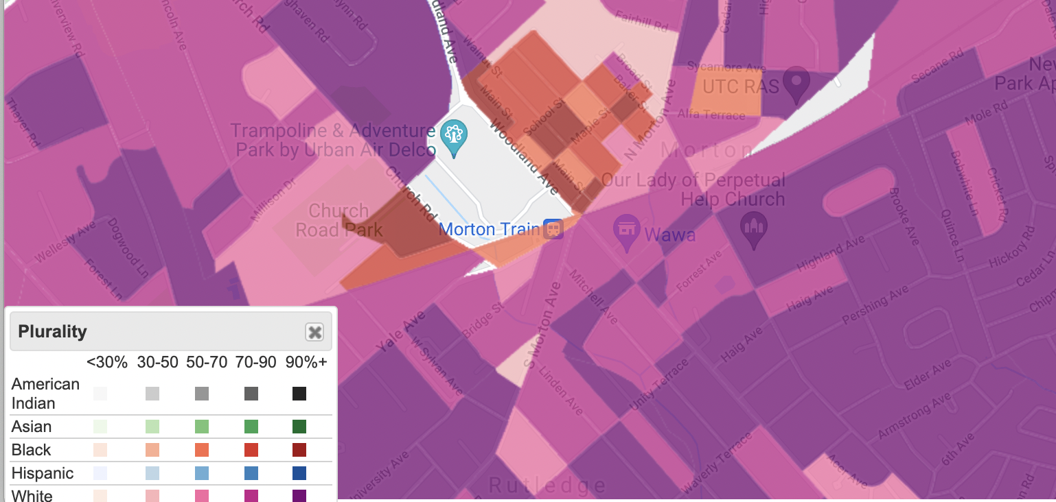
How does equity matter locally?
ACTIVITY: Continue your exploration of equity
Go to: Justice Map, a high resolution US Census Bureau map of race and income. Explore diversity and income facts of neighborhoods. Go down to
the street level.
DEI

Slide 23
“Equality is giving everyone the same pair of shoes. Equity is giving everyone a pair of shoes that fits.” (–Enid Lee)
… Take the next steps toward
equity with your League.
Thank you!

Slide 24
Additional Resources, 1 of 2
Activity: Equity vs. Equality, Source for adaptation: Shelly Tolchuk
Equity vs. Equality - Video
Essential Questions - What is an essential question?
LWVUS - Defining Diversity, Equity and Inclusion

Slide 25
Additional Resources, 2 of 2
“A Class Divided” - Video
American Wealth Inequity website
“We blog about racial equity and its nemesis Fakequity.”
Sun, Amy. “Equality is Not Enough; What the Classroom has Taught me about Justice.”
Wormeli, Rick. Fair Isn’t Always Equal, Stenhouse Publishers, 2018
Robert Longley. Thoughtco.com. Equity versus Equality What’s the Difference?

