Slide 1
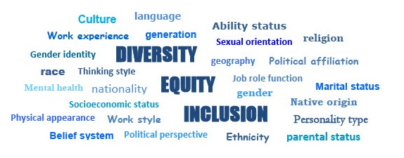
Module 4: What is Inclusion?
Diversity, Equity and Inclusion Learning Modules 2022

Slide 2
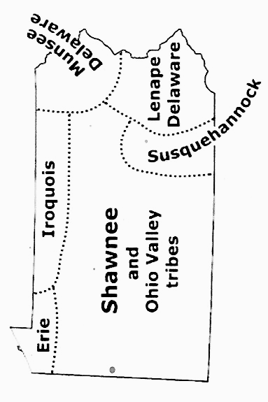
Land acknowledgement for Pennsylvania
.
Pennsylvania and Indigenous land map

Slide 3
Discussion Guidelines
Show Respect
Listen (it’s more important than speaking)
Speak to the subject at hand
We all may feel discomfort experiencing
new ideas and perspectives
Practice self-care
Not all problems will be solved now
Look for common ground

Slide 4
The LWVPA Equity Initiative, with local Leagues throughout Pennsylvania, has developed this series of five learning modules to build understanding of Diversity, Equity and Inclusion (DEI).
Welcome!
DEI Learning Module
4 of 5

Slide 5
Module 4:
What is inclusion?
Why is inclusion essential to the work of your League?
Who is included,
who feels like they belong within
these quotes?

Slide 6
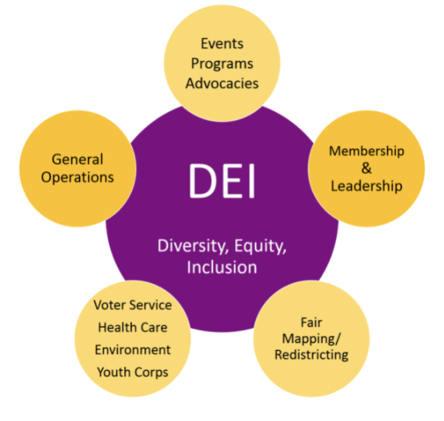
What are the essential questions
to ask about DEI?
What is diversity, equity,
and Inclusion (DEI)?
What is a League community?
Why is DEI important to your League and your community?

Slide 7
What are the essential questions
to ask about DEI?
How are diversity, equity, and inclusion interconnected?
What are some ways to
advance the DEI policy
In your League?

Slide 8
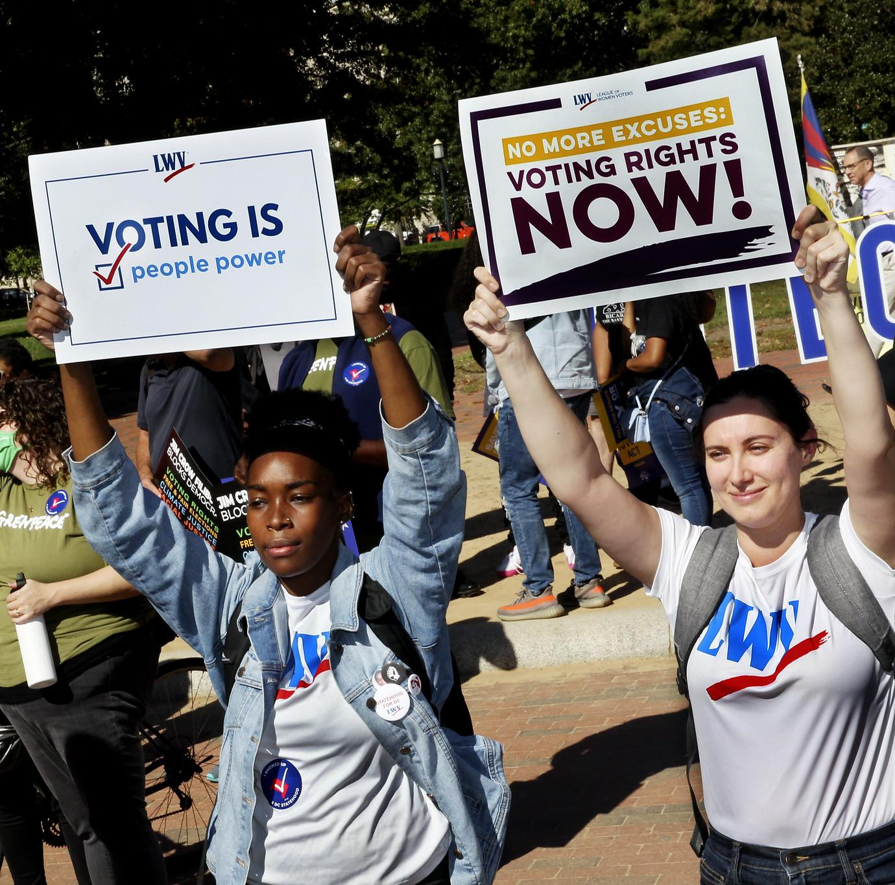
Do inclusion and belonging really matter?
Tomorrow belongs to those of us who conceive of it as belonging to everyone; who lend the best of ourselves to it, and with joy.
– Audre Lorde

Slide 9
Learning Objectives
for Module 4, Inclusion:
Understand
Identify
Understand
Inclusion and
It’s importance
In your League.
Inclusive best practices.
Does everyone feel included and welcomed?
What needs
can be Identified?
How to foster
Inclusion and welcoming in
your League Community.

Slide 10
Inclusion, a definition:
Inclusion authentically brings traditionally excluded individuals and/or groups into processes, activities and decision/policy making.
Diversity, Equity, and Inclusion Definitions
See also LWVUS Glossary of Terms

Slide 11
Democracy, a definition:
1 a : government by the people especially : rule of the majority. b : a government in which the supreme power is vested in the people and exercised by them directly or indirectly through a system of representation usually involving periodically held free elections.
2 : a political unit that has a democratic government.
Source: Merriam-Webster

Slide 12
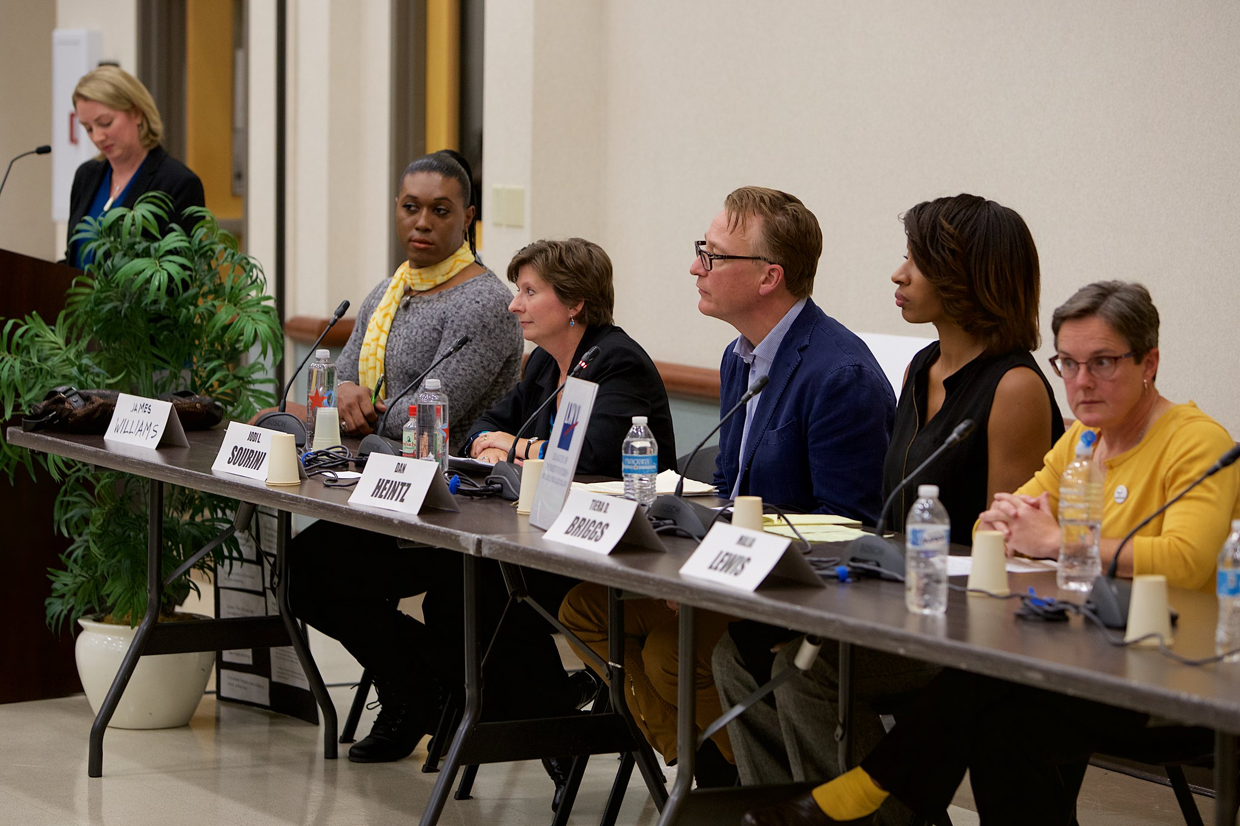
Inclusion is essential for democracy

Slide 13
Building a practice of inclusion
Statement A:
“Diversity is being
invited to the party.
Inclusion is being
asked to dance.”
Verna Myer - American leader in DEI Learning

Slide 14
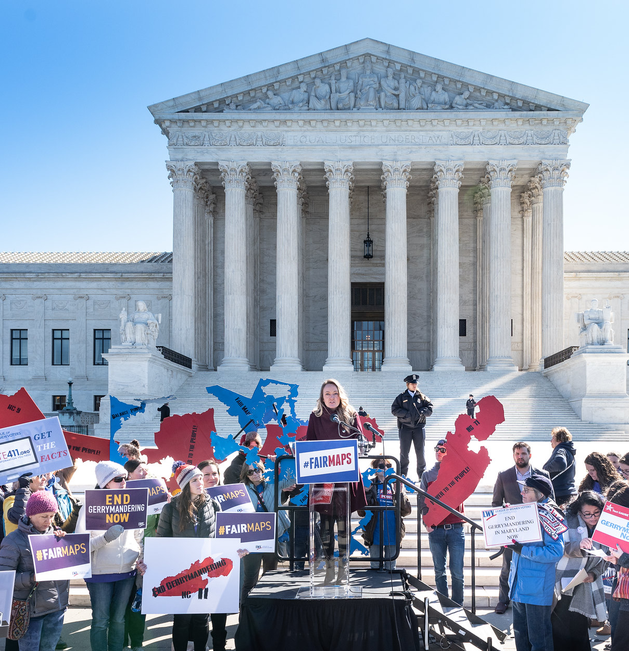
Building a practice of inclusion
Statement B:
“If you have come to help me, you are wasting your time. If you have come because your liberation is bound up with mine, then let us work together.”
Lila Watson Aboriginal activist

Slide 15
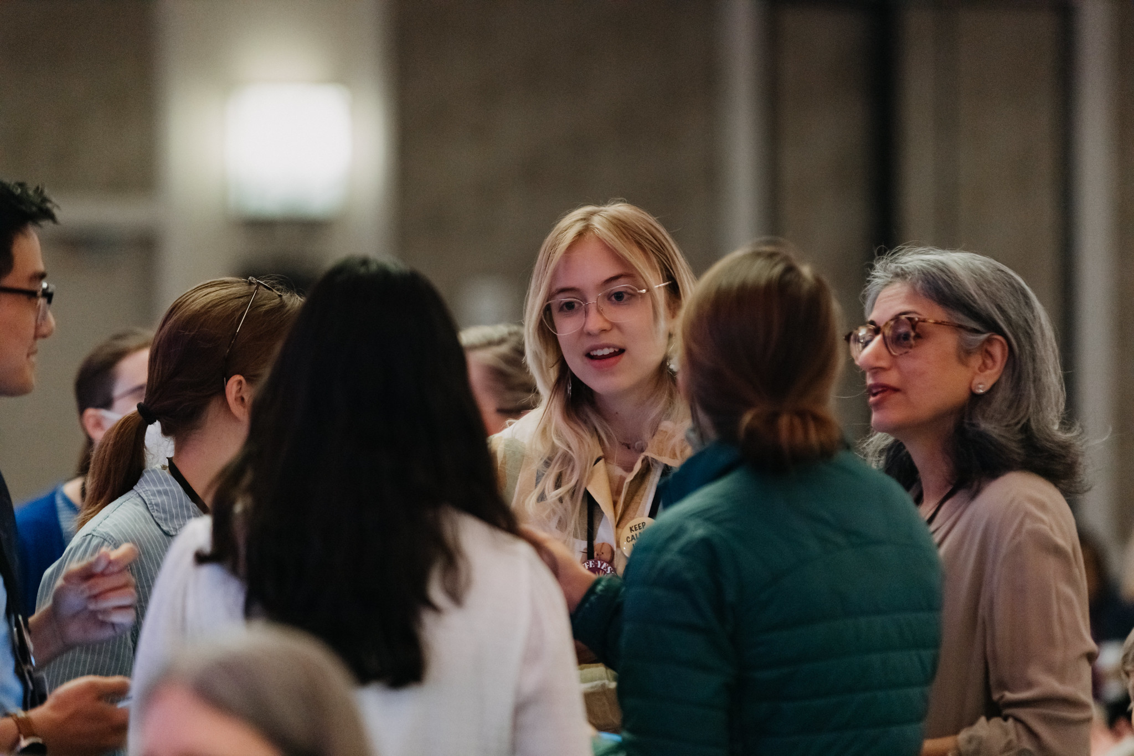
Inclusion
Group Problem Solving
2 Scenarios, 3 Steps:
Read scenario A and scenario B as a group.
Groups break into sub-groups of 2-4
(or break out rooms on Zoom) to discuss
Questions.
3. Return to main
group to share
responses.

Slide 16
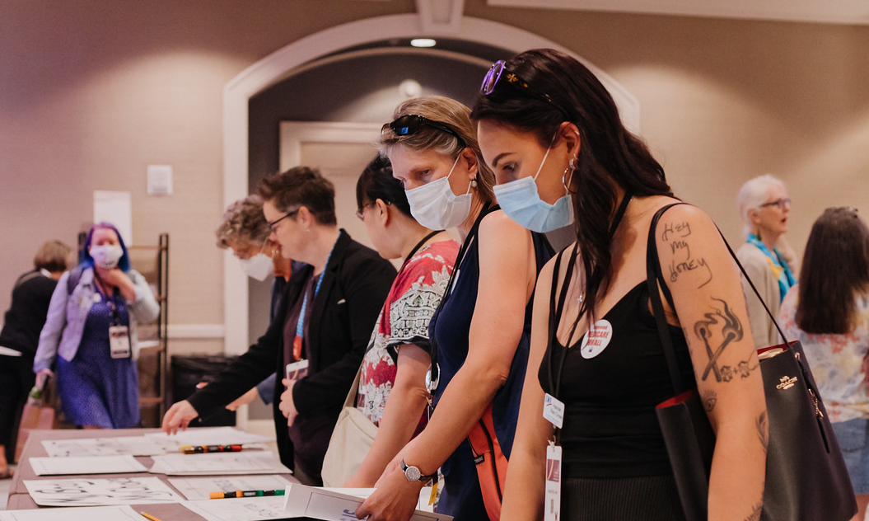
LWV DEI tools: Next steps for advancing
inclusion
• solve problems
• build welcoming
events and practices
•support an inclusive League environment

Slide 17
Conclusion and Call to Action
How are diversity, equity, and inclusion interconnected?
How will inclusive practices support the mission of your League?
What inclusive practices will your League embrace to ensure that all members and visitors experience a real sense of belonging?

Slide 18
References and Additional Resources
DEI Definitions: Diversity, Equity, Inclusion
DEI Lens What to ask when examining your League work
Recentering Justice Work - Guidelines for Change Audre Lorde - Activist, writer, poet
Lila Watson - Aboriginal activist, her life and story
Verna Myer - DEI Learning, unconscious bias and inclusion
Helen Kim Ho. 2017. 8 Ways People of Color are Tokenized in Nonprofits.
Peggy McIntosh. 1988. Unpacking the Invisible Knapsack.
LWVPA Equity Initiative Online Resources

