Slide 1
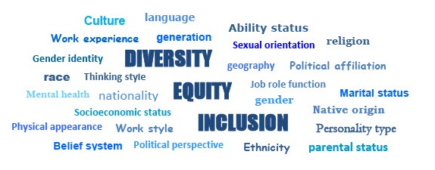
Module 5: Integrating DEI
Diversity, Equity and Inclusion Learning Module Series 2022

Slide 2
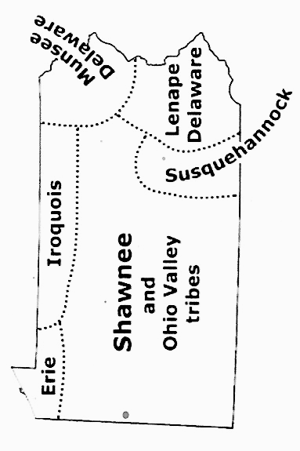
Land acknowledgement for Pennsylvania
.
Pennsylvania and Indigenous land map

Slide 3
Discussion Guidelines
Show Respect
Listen (it’s more important than speaking)
Speak to the subject at hand
We all may feel discomfort experiencing
new ideas and perspectives
Practice self-care
Not all problems will be solved now
Look for common ground

Slide 4
The LWVPA Equity Initiative, with local Leagues throughout Pennsylvania, has developed this series of five learning modules to build understanding of Diversity, Equity and Inclusion (DEI).
Welcome!
DEI Learning Module 5 of 5

Slide 5
Module 5:
What is Your Plan to Integrate DEI?
Put the DEI Policy
into practice in your League to become
a more diverse, equitable and inclusive organization.
‘‘...Diversity, equity, and inclusion are central to the organization’s current and future success in engaging all individuals, households, communities, and policymakers in creating a more perfect democracy.’..’
-LWV DEI Policy

Slide 6
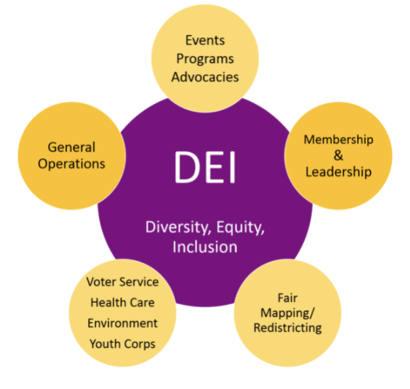
What are the essential questions
to ask about DEI?
What is diversity, equity,
and Inclusion (DEI)?
What is a League community?
Why is DEI important to your League and your community?

Slide 7
What are the essential questions
to ask about DEI?
How are diversity, equity, and inclusion interconnected?
What are some ways to
advance the DEI policy
in your League?

Slide 8
Learning Objectives
for Module 5 - Integrating DEI
Understand
Understand
Activate
League culture, League history and how these influence our perceptions, policies, and actions.
Why and how we embrace equitable practices and policies which allow everyone to participate.
An inclusive and welcoming culture in your League.
Continue to learn, excite change,
meet the future.
DEI

Slide 9
Our shared LWV DEI Vision
We imagine a League that:
Embraces and embodies diversity, equity, and inclusion
as inextricable from the mission to empower voters
and defend democracy.
Engages in purposeful action to advance diversity, equity,
and inclusion beyond words.
Commits at the individual and collective level to being more self-aware and understanding of diverse perspectives and experiences.
Is known for being relevant, diverse, equitable and inclusive - inside and out.

Slide 10
A Roadmap towards Culture Shift
In 2017, LWVUS research concluded that we could achieve transformation and
“...greater mission impact with a culture shift that focused on becoming more diverse, equitable and inclusive by applying a DEI lens to the work we do and making a concentrated effort to expand our education and knowledge of DEI both as an organization and individuals”...
LWVUS Transformation Roadmap

Slide 11
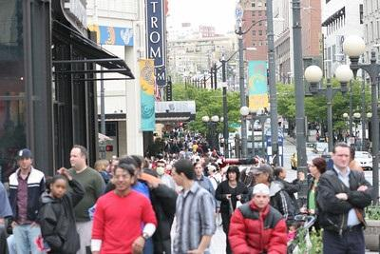
What is Culture and how does
it change?
Culture:
a. The customary beliefs, social norms, and material traits of a racial, religious, or social group.
Photo: "Crowded Sidewalks" by brianteutsch
Source: merriam webster

Slide 12
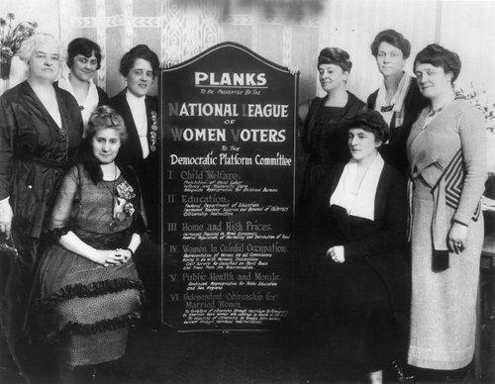
What is Culture and how does
it change?
Culture:
b. The set of shared attitudes, values,
goals, and practices that characterize
an institution or organization
Above: LWVUS photo 1920 Democratic Convention Definition: merriam webster

Slide 13
The Iceberg Model of Culture

Slide 14
What are aspects of culture?
An exercise in understanding culture using
the Iceberg Model

Slide 15
Aspects of Culture:
policies | perceptions
mission | feelings
strategies | values
goals | norms
bylaws | traditions
vision | stories
beliefs | rules
assumptions | structures
What is visible?
What is invisible? What are examples of these aspects? Where do they exist?

Slide 16
Visible or Invisible?
Visible
DEI Policy
DEI Policy
Invisible

Slide 17
Changing Organizational Culture
“Changing culture is a bit like changing the course of a large ship – it takes time to manoeuvre and whilst the engines are pushing one way the tides and winds are pushing another.”
Torben Rick: Why is organizational culture change difficult

Slide 18
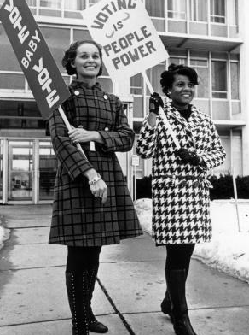
Greater LWV mission impact
is possible by embracing DEI.
• Fully embrace LWV values.
Take action beyond policy and words.
Engage with each other and all communities.
Be inclusive, connected - and able to be of real benefit to all: communities, groups, and individuals.
Continue learning - History of the League, DEI Lens, and more modules

Slide 19
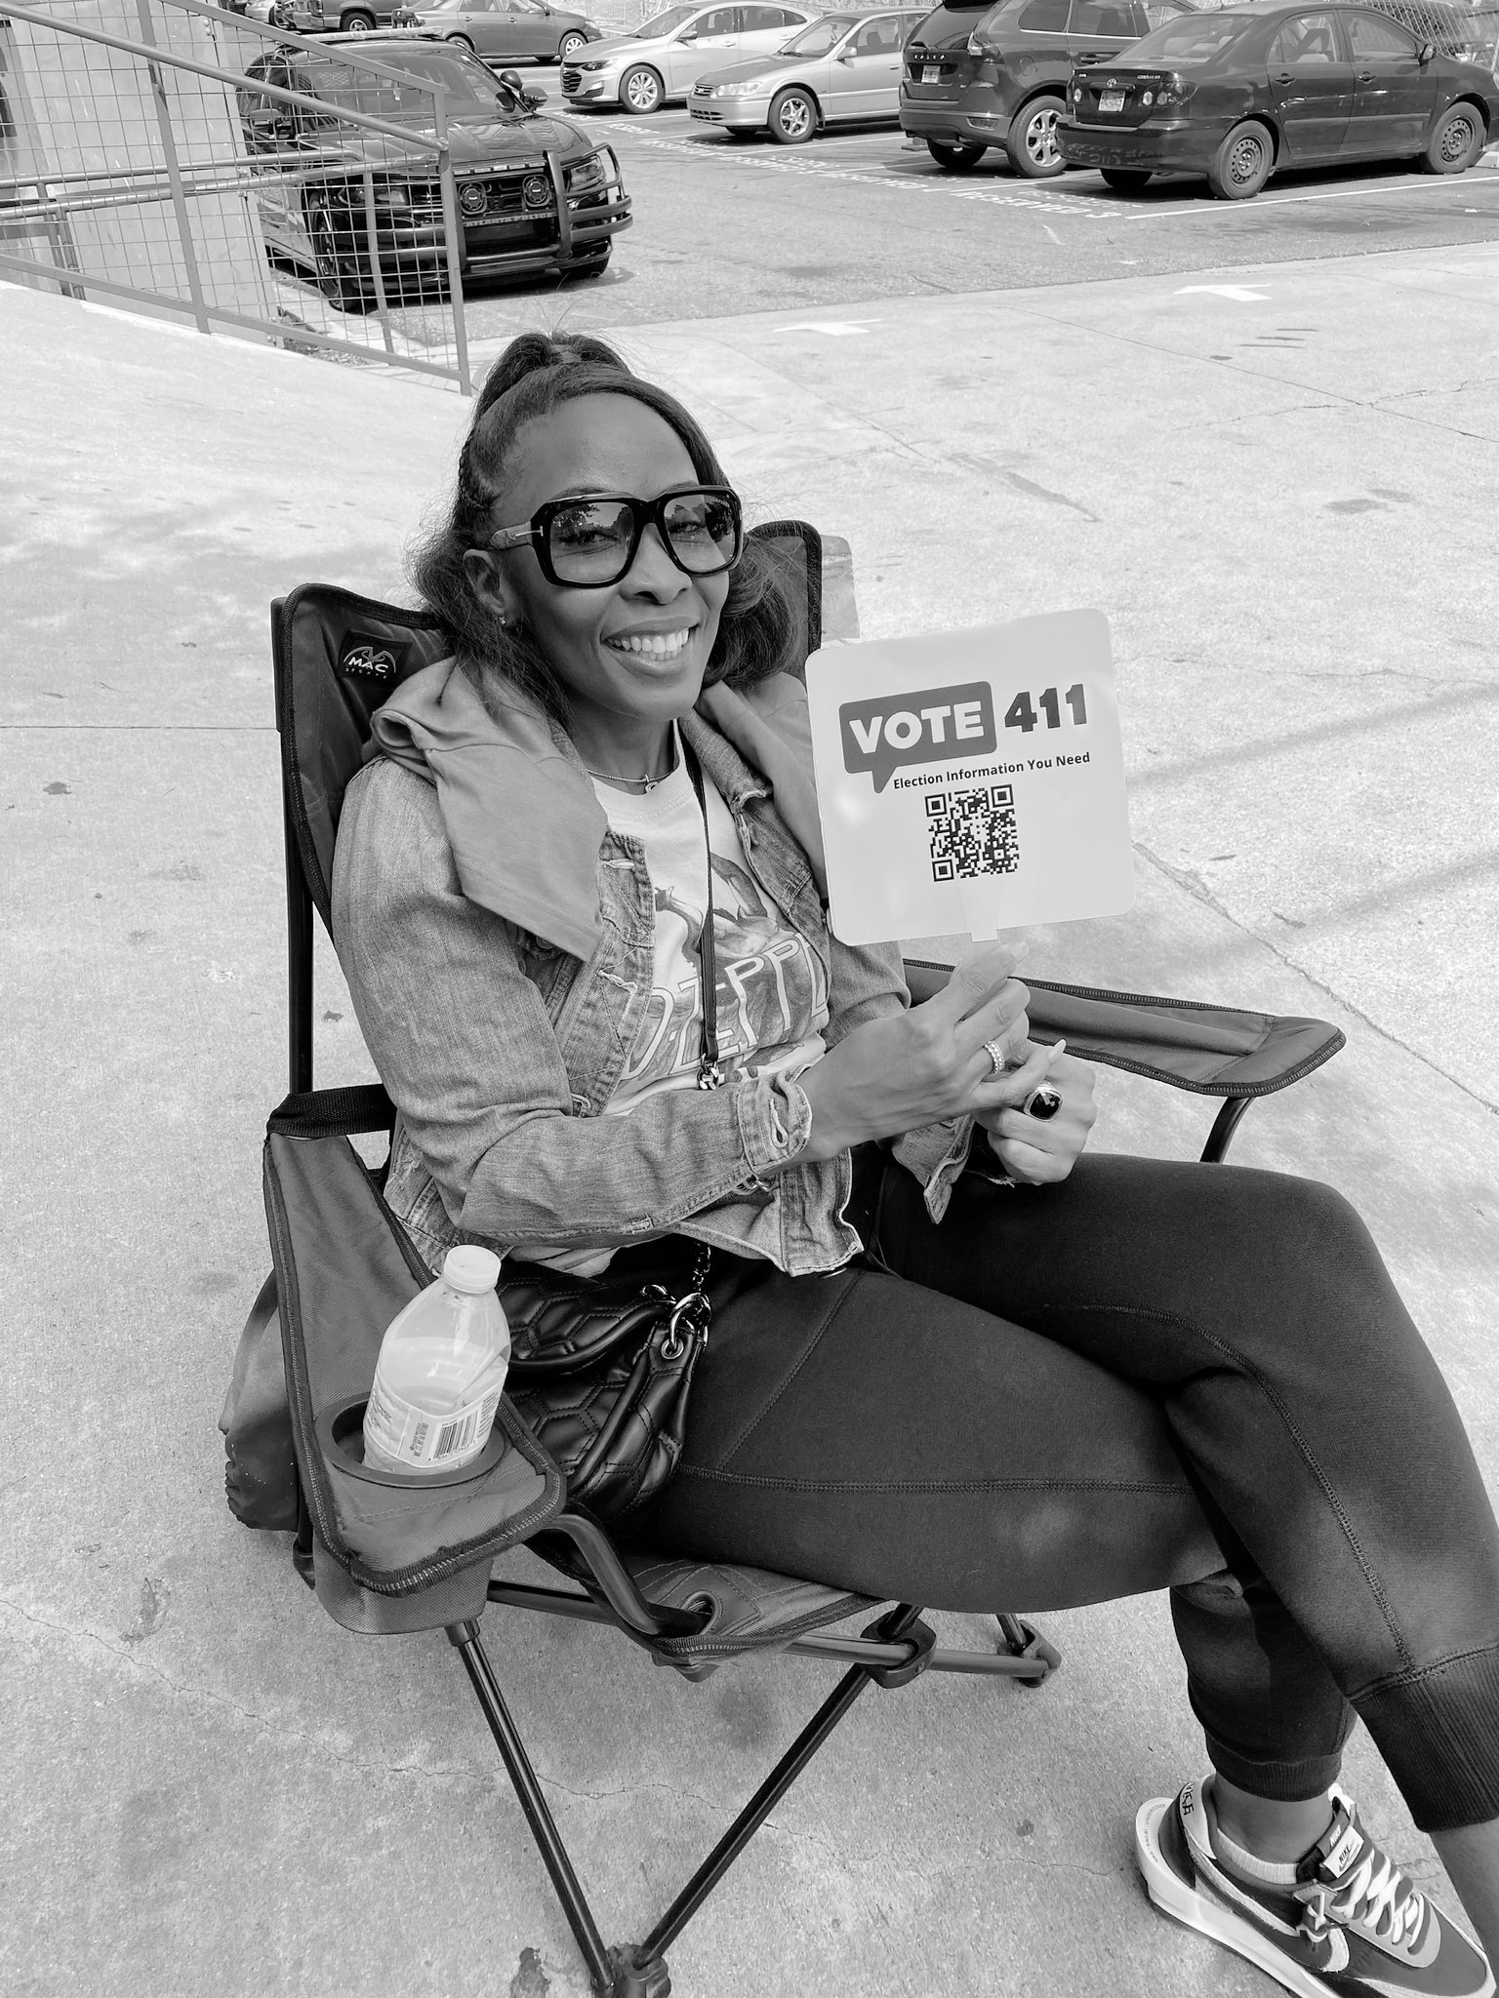
Greater LWV mission:
Defending Democracy.
The League of Women Voters is a nonpartisan, grassroots organization working to protect and expand voting rights and ensure everyone is represented in our democracy. We empower voters and defend democracy through advocacy, education, and litigation, at the local, state, and national levels.

Slide 20
DEI strengthens the LWV mission
Of Defending Democracy.
We envision a League with capacity to support and defend democracy in all our communities, branches of government, and support key stakeholders across the Commonwealth. We envision a League that Is known for being relevant, diverse, equitable and inclusive - inside and out.

Slide 21
Stay connected to DEI and build your League’s future:
If your League has not taken this step, join the LWVPA Equity Initiative today.
Contact equity@palwv.org for more information, resources, and support.
DEI
League of Women Voters of Pennsylvania ‹#›

Slide 22
References and Resources
LWV Transformation Roadmap: Transformation Roadmap
Definition of Culture: merriam webster
Iceberg of Culture: Edward T Hall Cultural Iceberg Model
Torben Rick: Why is organizational culture change difficult
LWVUS Webinar: Whys and What of DEI
Integrating DEI: C. Jefferson-Jenkins video
Understanding Intent vs Impact: Article: Why Detroiters Didn't Trust City Tree-Planting Efforts
DEI Success Stories: LWV of Dearborn/Dearborn Heights (MI) and LWV of Janesville (WI)
History of the League video (LWV of Greater Pittsburgh): Acknowledging our History, Growing a More Equitable Future

