Slide 1
SPRING 2023
WWW.SEVENTY.ORG

Slide 2
Who are we?
We’re the
Committee of Seventy
We’re voters. We believe that when more people vote and are better informed, democracy wins. Since 1904, C70 has led the effort in Philadelphia (and now, beyond the city) to make our government more representative, transparent, and accountable.
We continue to be nonpartisan civic leaders, and together with our partners, we’re here to provide citizens with everything Pennsylvanians need to vote in 2022 and every year after.
www.seventy.org

Slide 3
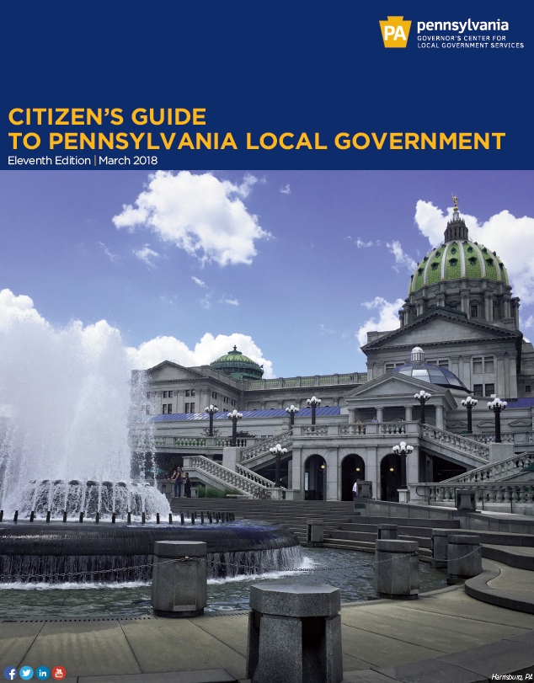
An Overview of Municipal Government
Legal origins and authority
Municipal and county structures and services
School districts and authorities
Notes:
Citizen’s Guide to Pennsylvania Local Government, 11th Edition, 2018
https://dced.pa.gov/download/citizens-guide-to-pennsylvania-local-government-pdf/

Slide 4
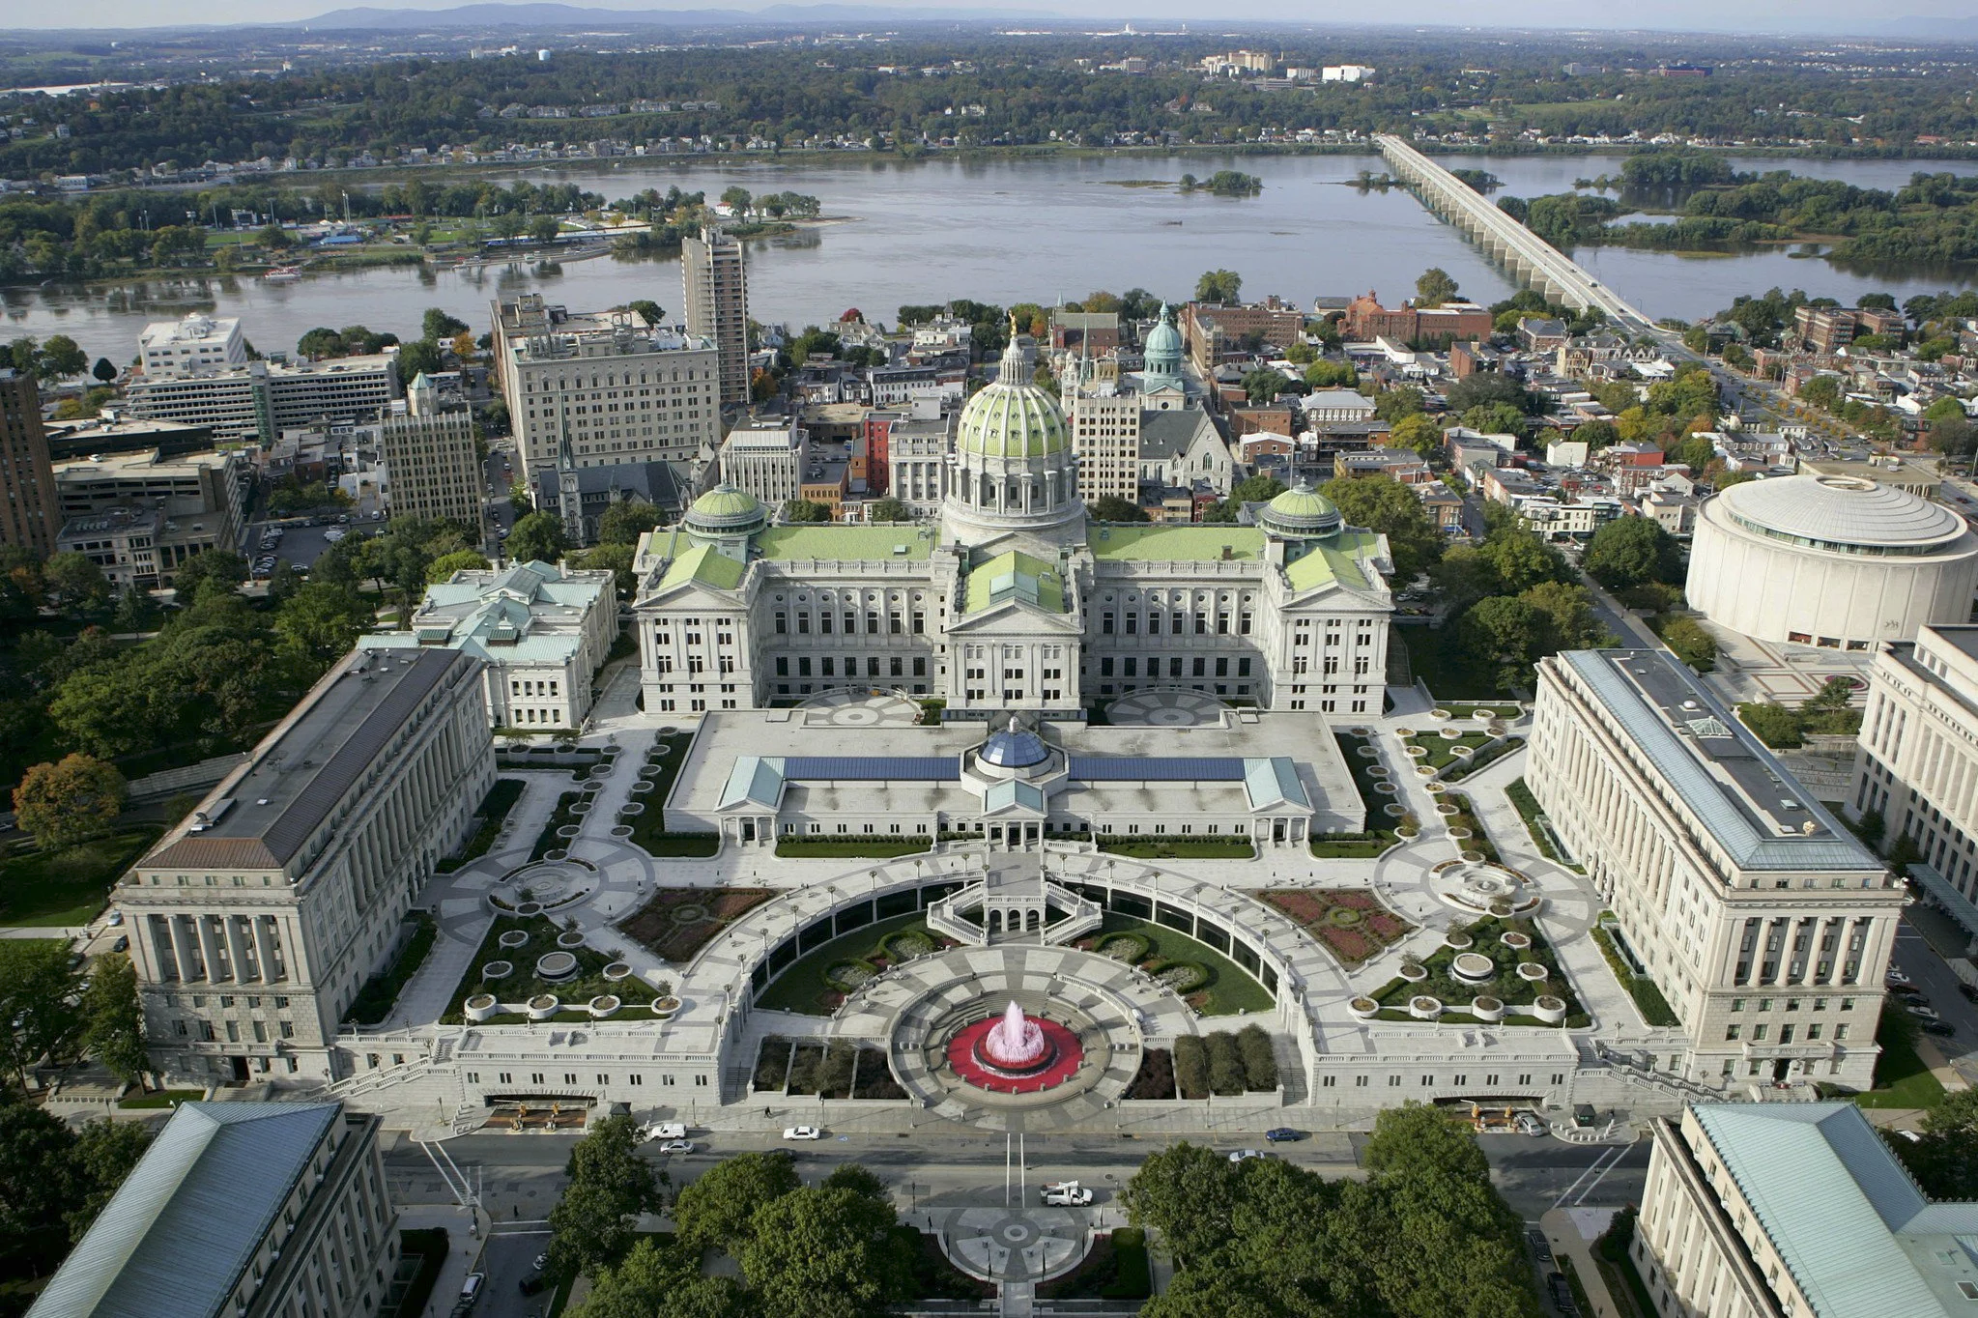
Where does local government come from?
Photo: Matthew Dressler
Notes:
Photo credit: Matthew Dressler

Slide 5
Creatures of the state
Pennsylvania’s Constitution authorizes the General Assembly to create different types of local governments
Home Rule Charter and Optional Plans Law gives citizens the power to determine for themselves the structure and duties of local government
Other Law
Municipalities Planning Code empowers municipalities to adopt zoning and land-use ordinances
Local Tax Enabling Act authorizes municipalities and school districts to levy certain types of taxes
Sewage Facilities Act regulates sewage disposal systems and requires that every municipality plan for and regulate sewage disposal
Notes:
KEY POINTS:
67 counties, 2,560 municipalities, 500 school districts
https://en.wikipedia.org/wiki/Local_government_in_Pennsylvania

Slide 6
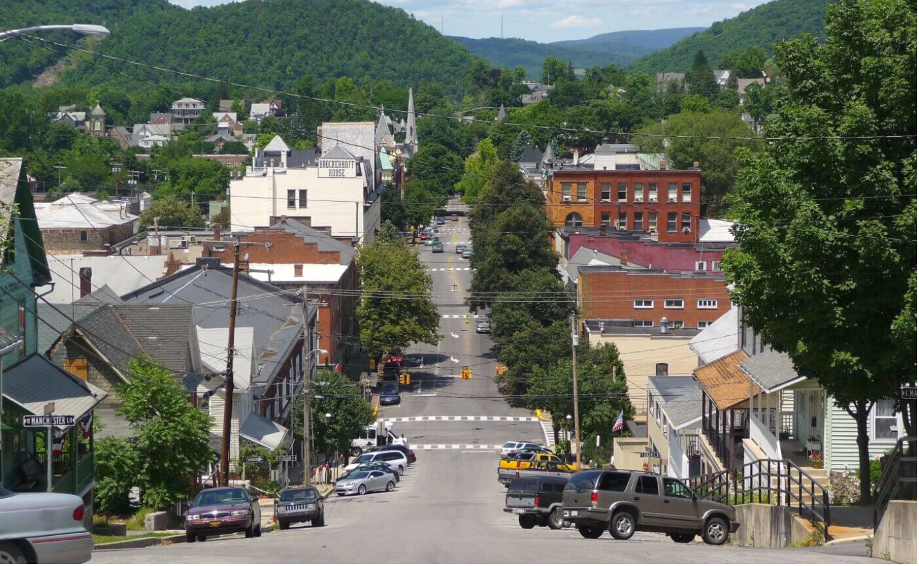
Types of local government
Photo: Jarryd Beard, Wikipedia
Notes:
Photo credit: Jarryd Beard/Wikipedia

Slide 7
Municipal Government: Boroughs
Borough council charged with governance, including hiring employees (eg, borough manager), approving a budget and expenses, passing ordinances
A borough not divided into wards has three, five, or seven councilmembers; in boroughs divided into wards, one, two, or three are elected from each ward. Councilpersons elected for four-year staggered terms
Mayor has oversight of the borough police department, may declare emergencies, may veto proposed ordinances
Tax collector and a board of auditors, controller, or appointed CPA to conduct an annual audit
Notes:
KEY POINTS:
tbd

Slide 8
Municipal Government: Cities
Third Class Cities
City council consisting of an elected mayor and 4-6 councilpersons (may be elected by wards)
Mayor oversees police, may declare emergencies and enforce ordinances
Elected treasurer collects property taxes and controller conducts audits
Optional Third Class City Charter Law allows for a 5, 7 or 9-member council elected at-large. Mayor, treasurer and controller are elected
Second Class & Second Class A Cities
Pittsburgh and Scranton have home rule charters
Mayor oversees operations, prepares budget and can veto ordinances Pittsburgh has 9-member council; Scranton has 5-member council
First Class City
Philadelphia has home rule, with a mayor & 17-member council
Notes:
KEY POINTS:
tbd

Slide 9
Municipal Government: Townships
All Townships
Board of commissioners as governing body
Elected tax collector and elected auditor or controller (or appointed CPA)
May appoint manager to oversee employees and operations
First Class Townships
Status must be approved by voters and requires minimum pop density
At least five commissioners elected at-large or by wards to 4-year terms
Second Class Townships
Three or five commissioners elected at-large to 6-year terms
Notes:
KEY POINTS:
tbd

Slide 10
Municipal Government: Basic Services
Public Instructure
Transportation
Sewer systems
Water
Streets (roadways, lights, signage)
Public Safety
Police and fire protection
Emergency management
Ambulance and rescue services
Environmental & Safety Regulations
Waste and recycling collection
Floodplain regs & stormwater
Building code enforcement
Land-use Regulations
Planning agency and comprehensive plan
Zoning and appeals boards
Recreation & other services
Parks & rec facilities
Libraries, hospitals, community services and events
Taxes, Fees & Assessments
Property, realty transfer, earned income, amusement, sin taxes
Fees for service (eg, permitting)
Notes:
KEY POINTS:
tbd

Slide 11
County Government: Structure & Services
Three county commissioners elected to 4-year terms
Appoint a chief clerk to assist in preparing annual budget, procurement
Appoint a solicitor, assessor, engineer and department administrators
Key functions
Property assessment (county board of assessment)
Elections (county board of elections)
Planning and land use
Social services (eg, children & youth, mental health, aging)
Court system (common pleas & magisterial)
Prisons
Emergency management (eg, 911)
Waste disposal & recycling
Environmental & agricultural regs, stormwater
Notes:
KEY POINTS:
tbd

Slide 12
County Government: Other Elected Offices
District Attorney is chief law enforcement officer
Controller is chief financial officer and auditor
Treasurer collects, invests, disburses and reconciles county funds
Coroner investigates causes of death
Sheriff provides court security, transports prisoners and manages property foreclosure and tax sales
Clerk of Courts maintains criminal records, bail payments, expungements, etc.
Prothonotary is clerk of the civil division (divorce, liens, civil suit docs & records)
Recorder of Deeds maintains real estate records (deeds, mortgages, sale docs)
Register of Wills validates wills, appoints executors, issues marriage licenses
Board of Jury Commissioners oversees jury selection for common pleas court
Notes:
KEY POINTS:
tbd

Slide 13
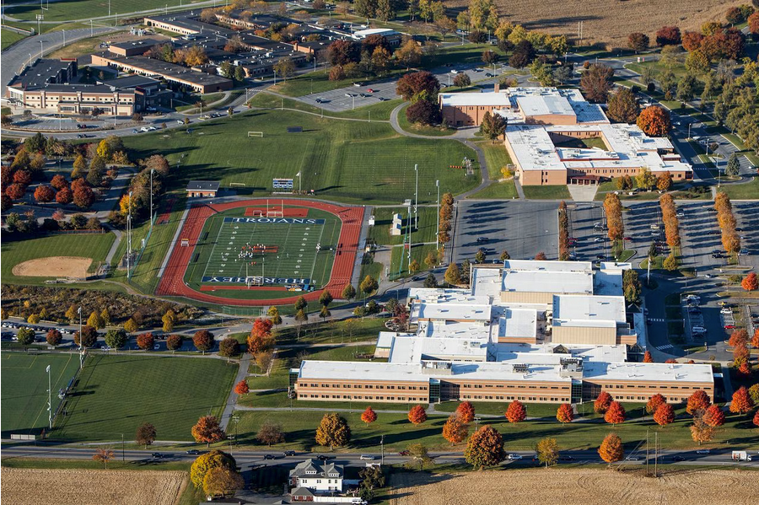
School Districts and Authorities
Photo: Dan Gleiter, PennLive.com
Notes:
A view of the Derry Township School District campus, including Hershey Early Childhood Center, Hershey Primary Elementary, Hershey Intermediate, Hershey Middle School and Hershey High School. Photo by Dan Gleiter, PennLive.com

Slide 14
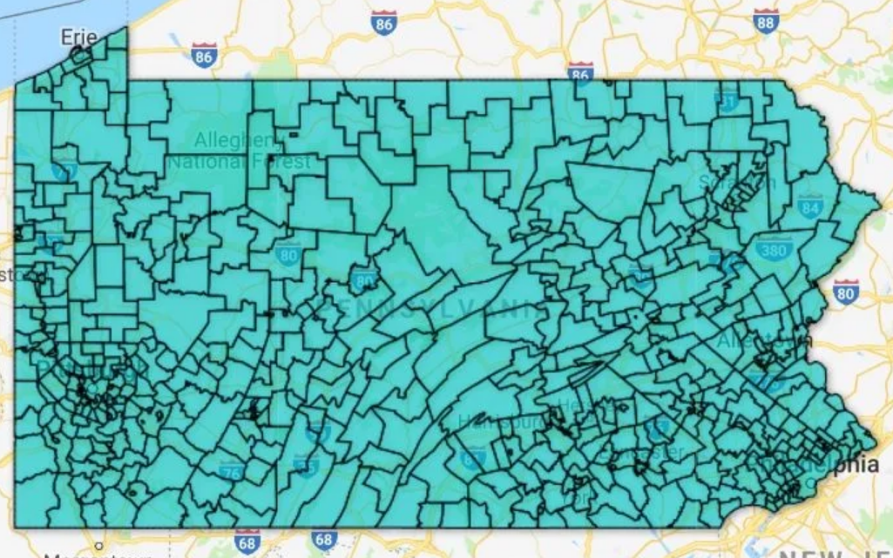
School Districts & Public Education
School Board of 9 elected members govern each district (taxes, labor, administration, education policy) and hire the superintendent
Funding primarily comes from property taxes, state and federal funding
Intermediate Units provide additional support (eg, professional development)
PA Department of Education certifies teachers, advises curriculum development, administers state funding, approves building/facility plans
Notes:
KEY POINTS:
https://whyy.org/articles/why-are-there-so-many-school-districts-in-pa-here-are-four-reasons/

Slide 15
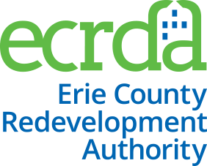
Municipal Authorities
Entity created to finance and/or operate public works projects
Funding: Costs of the project also typically covered by revenue from the project
Creation: Municipalities, counties and school districts can individually create authorities or together can create joint authorities
Governed by a board appointed by the local governments that created the authority
Functions: Parking, airport, transit, economic development, water, sewer, stormwater, business district, etc.
Notes:
KEY POINTS:
https://dced.pa.gov/download/municipal-authorities-in-pennsylvania/

Slide 16
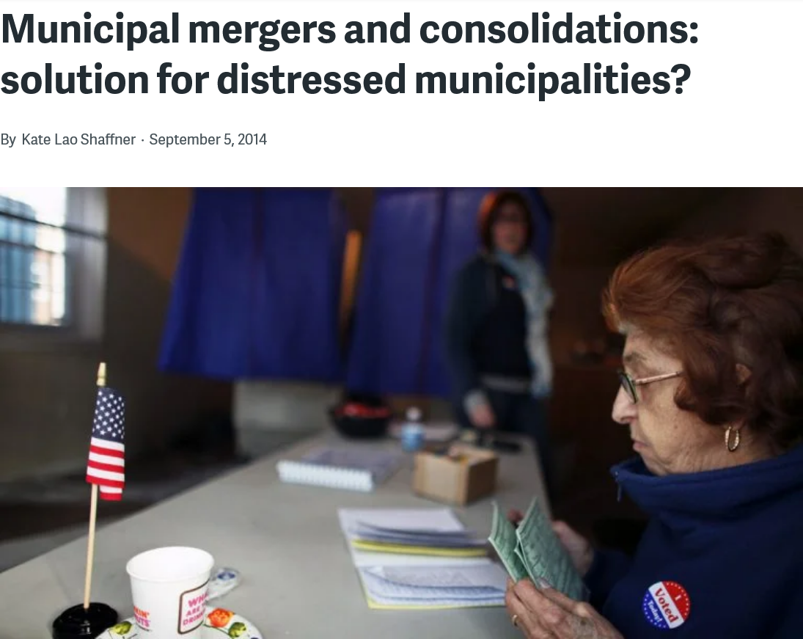
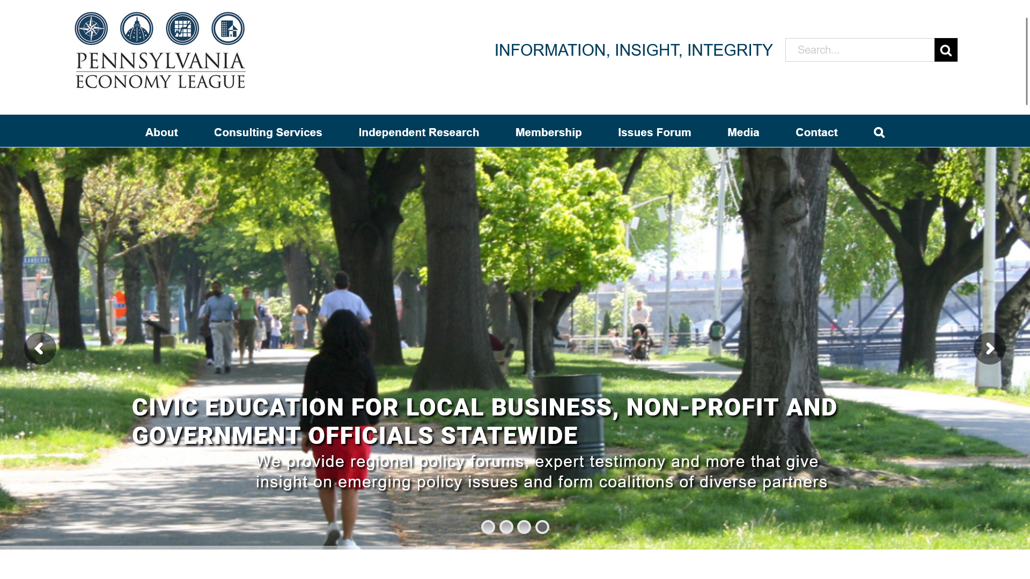
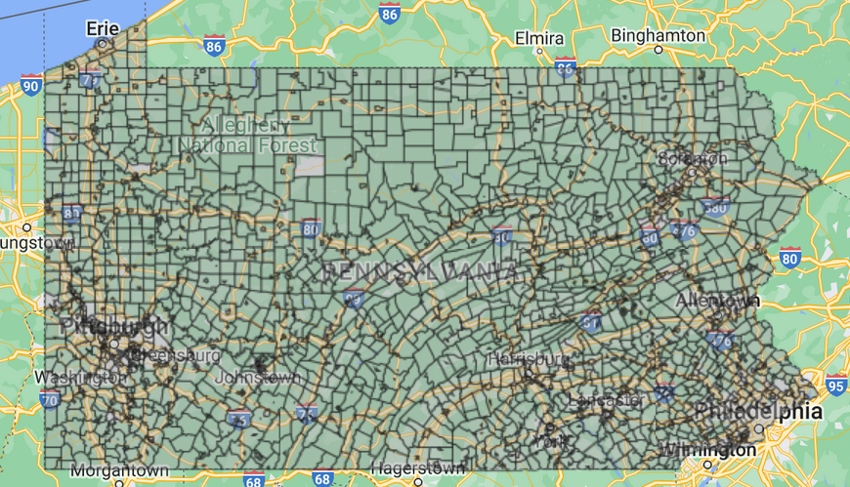
Notes:
KEY POINTS:
https://whyy.org/articles/mergers-and-consolidations-how-municipalities-change-boundaries/

Slide 17
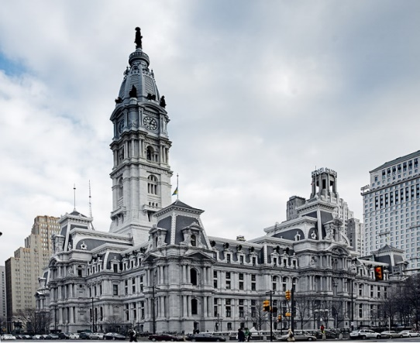
Philadelphia Government
Philadelphia Home Rule Charter
The Charter is like the city’s “constitution,” describing the overall structure of government:
Legislative branch (City Council)
Executive-administrative branch (Mayor)
Public integrity laws
Public education (school board & super)
Charter amendments require at least 12 City Council votes and approval by simple majority (50%+) of city voters.
Philadelphia Code
Ordinances passed by Council with a majority vote (9 of 17) and signed by the Mayor become part of the city Code.
Notes:
KEY POINTS:
Article XII: Public Education describes the construction of nine-member, appointed school board with terms coterminous with that of the mayor
The City Code includes numerous sections of law covering almost every aspect of daily life: building, health, housing, streets and traffic, parks and recreation, water and sewer, planning and zoning, business activity, public safety and individual behavior (eg, animals, posting signs, marijuana possession)

Slide 18
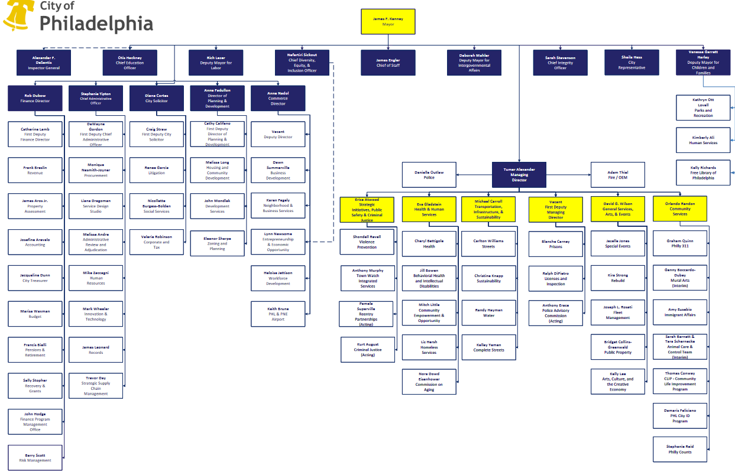
Philadelphia Mayor
City Departments
Law
Commerce
Police
Public Health
Fire
Streets
Parks and Recreation
Water
Public Property
Licenses and Inspections
Records
Auditing
Procurement
Prisons
The Mayor and their administration enforce the law, set budgetary priorities, and manage the operations of city government. The Mayor can serve up to two four-year terms.
Municipal services are provided by city departments, most with a commissioner appointed by the Mayor.
Notes:
KEY POINTS:
Mayor’s Cabinet: Mayor, Managing Director, Director of Finance, City Solicitor, Director of Commerce and City Representative
Auditing Department is run by an elected City Controller

Slide 19
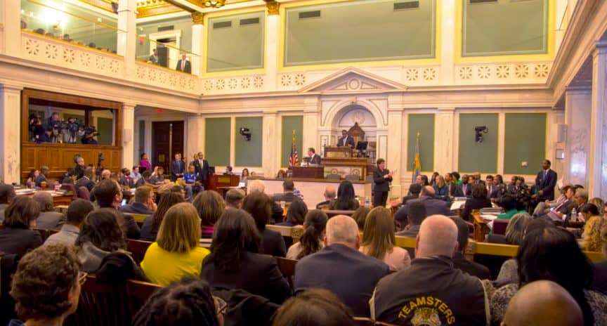
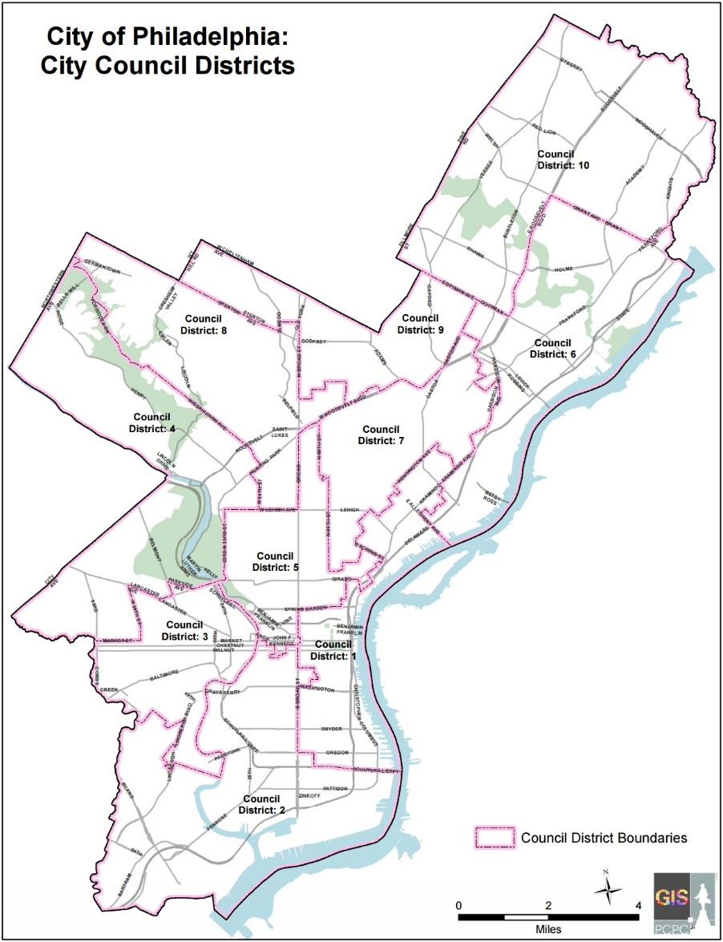
Philadelphia City Council
Philadelphia City Council consists of 10 district and 7 at-large members who serve four-year terms (no term limits)
Pass bills and resolutions
Conduct hearings on legislation and various public issues
Approve the budget
Notes:
KEY POINTS:
Bills passed and signed by the mayor become part of the Philadelphia Code
Resolutions are another form of legislation that must be approved by City Council, but they differ from bills in that they deal only with Council-related matters that don’t affect other parts of government, such as setting up the rules or organization of Council or authorizing investigations by Council committees. Often, resolutions are used for ceremonial purposes, such as congratulating successful Philadelphia residents and organizations or for honoring important guests.
Images: http://phlcouncil.com

Slide 20
Which level of government does what
Federal | State | Local
National security, defense Foreign policy Produces currency Economic, fiscal policy Medicare, medicaid, VA Social security and welfare benefits Federal highways, airports and rail US Postal Service Various laws & policies that cover states and localities | Medicaid administration Higher education, K-12 standards and funding Health and human services Police State highways and bridges Various laws & policies that cover localities (eg, environment, voting, criminal code, estates, deeds/mortgages, agriculture) | Schools Police, fire services Land-use and zoning Building requirements and inspections Health and human services Prisons Parks and recreation Libraries Local roads Sewer and water Trash and recycling
Notes:
KEY POINTS:
TBD

Slide 21
Ways to get involved
Volunteer as a block captain
Serve as a poll worker
Run for committee person
Join your local civic or neighborhood group
Support an advocacy group or cause
Vote
Notes:
KEY POINTS:
Bills

