Slide 1
Local League Capacity Building:
Building an Internship Program Presented by Meg Pierce, Executive Director January 24, 2023

Slide 2
Benefits of Internship Programs
Attract younger and more diverse members and new talent
Build greater equity within your League by welcoming new ideas and experiences
Additional capacity for your League to take on new projects
Offers students or recent graduates the chance to gain professional experience

Slide 3
Steps for a Successful Program
Decide the areas in which your League could use support
Decide what capacity (time and resources) your League has to supervise an intern.
Establish a realistic timeframe (e.g. semester/election cycle) and goals for the internship
Develop an internship description using a DEI lens; share your internship description widely
Develop a fair and transparent hiring process
Establish a feedback / review process
Notes:
Will break each of these down in the next slide

Slide 4
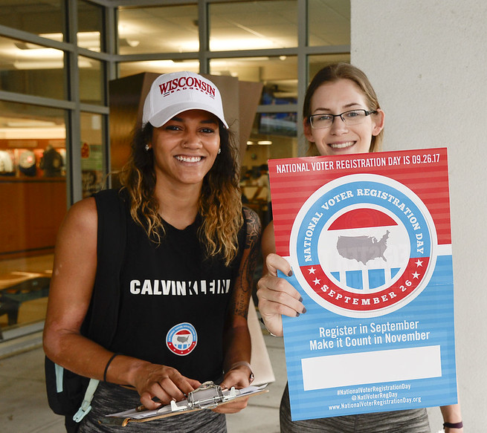
Define Support Needed / Capacity
Decide the areas in which your League could use support:
Voter services
Development/Operations
Membership/Equity
Policy/Communications
Decide who should supervise: Interns should have at least one direct leader to report to. Many students, especially high school students, will require guidance.

Slide 5
Timeline and Goals for Internship
Establish a realistic timeframe
Hiring should begin 1-2 months before the start date
Benefits of semester / summer
Election cycle
Establish goals for the internship
Manage Vote411 data
Support set # of community events
Write a white paper / policy research report
Establish/manage social media accounts
Write newsletters, fundraiser appeals

Slide 6
Developing an Internship Description
Internship description should:
Introduce the League
Include DEI/nonpartisan policies
Describe the position with specific examples of activities
Describe qualifications desired
Define “must have” experience versus “preferred but not required” experience
Include application submission requirements and a firm deadline to apply.
Include if the position is paid, and how much.
Notes:
e.G must have – experience using social media. Preferred – additional language skills.

Slide 7
Sample Internship Description
Follow link here.
Notes:
here

Slide 8
Develop a Transparent Hiring Process
Set up Zoom or phone interviews – offer realistic times for a student schedule
Offer disability accommodations for interviewees; e.g. closed captioning on Zoom
Ask candidate their preferred pronouns
Evaluate candidate based on experience, interest, and strength of application, not by how their level of education, current school, or physical presentation.
Keep interview to 30 minutes – maintain professionalism over familiarity: this is a job!
Ask intern how the experience will benefit their career or future plans
Leave time for questions from your candidate
LWVPA can provide sample interview questions if needed!

Slide 9
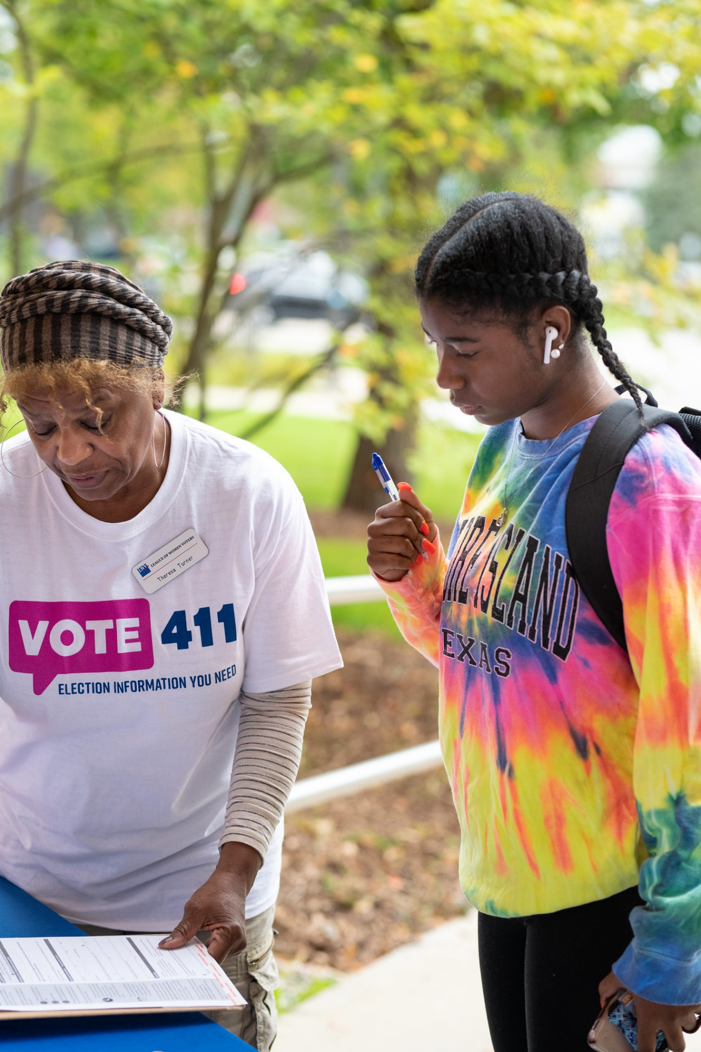
What About Payment?
According to the Fair Labor Standards Act, nonprofit and government agencies are not required to pay interns.
LWVPA does not recommend this as an issue of equity.
Option: Internships for credit
Stipend – LWVPA, LWVUS grants an option for internship programs.
Notes:
Unpaid internships overwhelmingly benefit white, wealthy students who can afford to spend time at an internship for free, therefore perpetuating cycles of inequity.

Slide 10
How to Share Your Internship Description
Your website – VERY important!
University/ high school educators in your League network
Social media
Handshake – job posting platform

Slide 11
Spotlight on Sam!

Slide 12
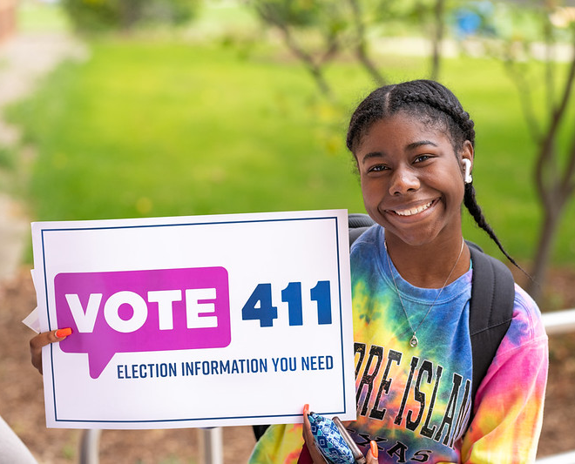
Questions / Discussion

