Slide 1
Central Bucks School Board
A TIMELINE 2021-2023
Amy McGahran

Slide 2
November 16 & 17, 2021
New York Times, The Daily Podcast
SCHOOL BOARD WARS Parts 1 and 2
This two part podcast is entirely focused on the Central Bucks School Board
"Seemingly overnight, a new battleground has emerged in American politics: school boards. In these meetings, parents increasingly engage in heated,-sometimes violent-fights over hot button issues.”
Notes:
The New York Times Podcasts in Nov 2021, alerted the public across the nation to the intensity of the culture wars across the country using the CB school district as an example. CB is a real flashpoint for the culture wars currently raging in our nation. Let’s take a look back to explore the evolution of this crisis in PA.

Slide 3
2021
Paul Martino, a Doylestown resident, venture capitalist and member of the Federalist Society, starts Re-Open PA/Re-Open Bucks. This PAC, in 2021, donated over half a million dollars to fund candidates for school board who opposed Covid health and safety protocols.

Slide 4
May 25, 2021
In a surprise vote, just prior to the adjournment of the School Board Meeting, a motion is made to reorganize School Board leadership positions.
The vote passes 5 – 3 with one abstention. The new School Board majority is able to set agendas for future meetings

Slide 5
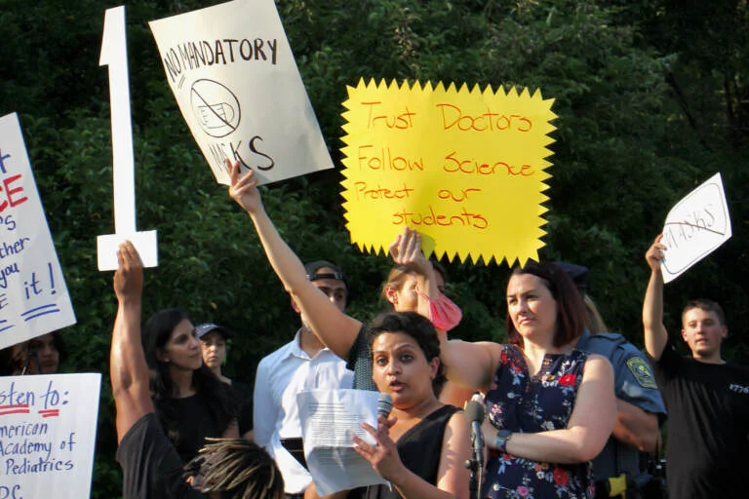
August 2021
Press conference to support masking in schools turns into shouting match with pro and anti maskers
August 25, 2021 – Central Bucks School Board votes down, on a 5 –4 vote a mask requirement and tighter COVID-19 mitigation measures.

Slide 6
November 9, 2021
Five School Board Directors are voted into office, three Republicans and two Democrats.
One of the candidates wins by less than 80 votes.
Two of the elected Board Members are members of Moms 4 Liberty
Notes:
One of the new school board directors, spoke at a previous school board meeting and said” Right now as we speak, there are demonic adults recruiting, brainwashing, and participating in unconscionable behaviors with children and every one of you knows it”

Slide 7
May 6, 2022
Teacher Andrew Burgess, who is an advocate for LGBTQ students, is placed on a sudden leave of absence. Some parents and students believe he is being disciplined for providing contact information for the U.S. Department Office of Civil Rights.
Mr. Burgess is moved to another school for the 2023 school year. He is again put on leave in April of 2023. He has recently filed a suit against the school district.

Slide 8
June 2022
Superintendent Abram Lucabaugh orders Pride Flags to be removed from classrooms. The Superintendent explained the decision by comparing pride flags to political flags, and by noting that pride flags had become divisive.

Slide 9
After months of pushback from parents, educators, students, librarians, the ACLU Pennsylvania, and the Education Law Center of Philly, the Central Bucks School Board passes the most restrictive library policy in the Commonwealth, library policy 109.2

Slide 10
July 26, 2022
The vote is 6 to 3. The decision on what books to have available to children is no longer the decision of trained librarians, but the School Board.

Slide 11
July 26, 2022
Due to the backlash from the book ban, the superintendent recommends, and the board votes 6 to 3 to retain public relations firm, Divine and Partners at a cost of $15,000 a month. After 6 month the PR firm resigns.

Slide 12
October
2022
The US Department of Education announces it will investigate Central Bucks School District, following an ACLU complaint alleging "hostile" environment for LGBTQ stufents.

Slide 13
October 11, 2022
Draft Policy 321 is introduced to replace current policy 321. The revised policy will codify pride flag removal and prohibit classroom discussion of anything considered sociopolitical,
Notes:
Teachers are fearful and unsure of what is allowed to be discussed and displayed in the classroom. Staff morale is at an all time low and teachers begin to resign and retire early.

Slide 14
November 15, 2022
The Central Bucks School Board votes 6-3 to hire former U. S. Attorney William McSwain to represent the district following the ACLU of Pennsylvania’s federal complaint alleging the district has created a “hostile environment” for LGBTQ student. His fee for service is $940/hour. Bill McSwain ran for Governor of Pa in the 2022 primary, during which he posted a photo of a West Chester Area School District Gay-Straight alliance club sign on Facebook and wrote, “This ends when I’m governor.”

Slide 15
January 10, 2023
After 90 minutes of public comment, policy 321 passes with a 6 –3 vote.

Slide 17
January 27, 2023
The forced removal of Elli Weisel quote at a high school library causes public outcry and receives national media attention. The quote is said to go against the new policy 321. Administration allows the return of the quote at school library but shortly after the school librarian retires early.’
Notes:
Policy 321 requires “neutrality in the classroom”. There is no explanation of how this is to be applied and enforced. This quote is a powerful example of how censorship can adversely effect learning.

Slide 18
We must take sides. Neutrality helps the oppressor, never the victim. Silence encourages the tormentor, never the tormented’

Slide 19
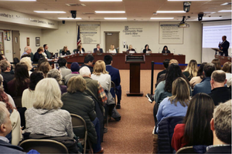
April 2023
The School Board calls special meeting to present finding of the McSwain law firm investigation. Cost to tax payers 1.4 million. Findings – A teacher and a Democrat school board member are to blame for the ACLU investigation. The sham report finds no fault with the school administration and no hostile environment for LGBTQ students.
Notes:
Keep in mind the Office of Education investigation’s findings have not yet been presented.

Slide 20
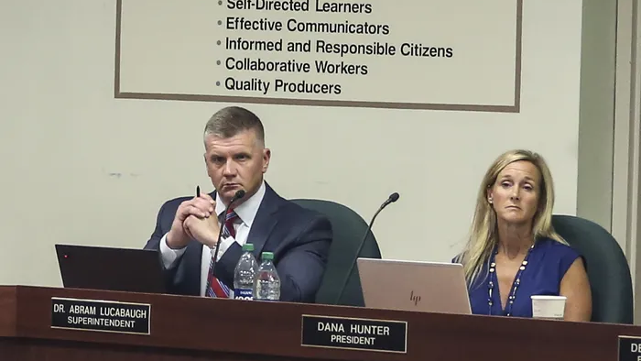
July 2023
The Superintend gets a surprise new 5 year contract with 3 years still remaining on current contract. He receives a 40% $90k raise plus increase of benefits. New contract and raise passes with a 6-3 vote. There is no discussion of how and who negotiated this contract.

Slide 21
August 2023
Policy 123.3 Which addresses sex based distinctions in athletics is introduced. This new policy, if passed, will discriminate against transgender students in school sports. The ACLU has warned the district that this is illegal.

Slide 22
Sept 2023
As of September 2023, 70 books have been challenged and 2 have been removed based on the new library policy
It costs the district $1,000 for each book review.

Slide 23
September 12, 2023
The school board meeting hits a new low with verbal attacks on school board members, school board candidates and a teacher.
This escalates to a brief altercation when a public commenter threatens a school board member. The meeting is briefly stopped while police remove the two men involved.

Slide 24
November 7, 2023
Please vote in your school board elections and encourage your friends and family to do the same.
This is not an isolated instance of this sort of controversy. School boards across the country are facing similar challenges. Be informed about your candidates
Use Vote411.org to get information on where your candidates stand on the issues
If the candidate is unwilling to participate in our nonpartisan survey, you should be concerned.

