Slide 1
Building Resilience to Mis- and Disinformation
September 12 2023
Notes:
My name is [NAME] and I’m [title & affiliation].
The League of Women Voters in partnership with the Algorithmic Transparency Institute have assembled a training to help us work to address mis- and disinformation spreading in our community.
I attended a training session to learn about this process and now I’m here to teach you what I learned so that we can work together to tackle this challenge.

Slide 2
Today’s Agenda
Understanding the landscape
Defining the problem
Responsible engagement
Active participation
Notes:
Before we get started, I’d like to walk you through today’s agenda so you know what we will be covering.
First, I will give an overview of the landscape in which this work takes place.
With that context, we will then explore how we define this complex problem, looking at the tactics, appeal, and motivation common to misleading messages.
Once we establish that foundation, we will turn to thinking about when and how to engage responsibly to tackle problematic content
After we discuss response we can talk about participation through volunteer engagement where I will explain how you can sign up to take an active part in collaborative action.
Let’s get started!

Slide 3
Mis- and disinformation drive cycles of fear and polarization, risking:
Trust in our institutions
Health & safety
Radicalization & civil unrest
Notes:
Misinformation spreading on social media has become a fact of life: it fuels polarization and hate, it drives down trust in institutions, it amplifies fringe science and conspiracies, and it incites violence. Every political and social issue we hope to address is now impacted by the threat of false and misleading claims that can confuse and radicalize the public.

Slide 4
There is no silver bullet.
Notes:
Unfortunately, this is a complex problem and there is no silver bullet to solve it. Social media platforms and fact-checkers can't moderate us out of this downward spiral, and no act of Congress can effectively restrict the flood of misinformation that is likely to continue unabated.

Slide 5
We all share the responsibility for addressing misinformation.
Notes:
Instead, building capacity within our communities to establish resilience to the impact of misinformation is critical. If we cultivate a shared sense of civic responsibility for understanding and identifying harmful and misleading messages and then invest energy in constructively engaging with one another we can build the necessary bridges and find the common ground required to engage the whole of our society in an effort to improve our discourse.

Slide 6
look like?
What could a
Recognizing that everyone can be affected regardless of their political perspective.
Taking an active role in improving our public discourse and countering the harm caused by misinformation.
Acknowledging that misinformation doesn’t look the same in every community. Responses must be community-based.
“whole of
society effort”
Notes:
We are here today to realize this idea of a “whole of society effort”. Let’s start by thinking about what that really means: It means we acknowledge that we all share a responsibility and civic duty to understand and address the misinformation corrupting our discourse.
It means embracing that everyone can be affected by and contribute to mis and dis-information regardless of their political perspective.
It means taking responsibility for actively working to improve our public discourse by learning more effective techniques to mitigate the harm caused by mis and disinformation.
It means recognizing that misinformation looks different in each community and we need to tackle it everywhere, not, for example, just in white English-speaking spaces. Much of the attention paid to the spread of misinformation has focused on majority communities, and mainstream English-language concerns. Effectively combating the challenges posed by mis- and disinformation means that solutions cannot be imposed from the outside. Instead we must empower those within a community to develop approaches that will resonate with them so they are both invested in the outcome and able to tailor their approach based on their unique cultural knowledge.

Slide 7
Whatever the form
misinformation disinformation rumors
junk news conspiracies hate speech
it is all harmful.
Notes:
As we think about addressing problematic messages, it is important to start by recognizing that the information that pollutes our discourse comes in many forms. Whether we’re talking about misinformation or disinformation, rumors or conspiracy theories, junk news, or even hate speech, regardless of the form, it all misleads. For our purposes, the distinctions between these various forms are less critical, than our awareness that in the end, the impacts they create are the main concern and the one we seek to address regardless of the intent of the messenger, or specific language of the message.

Slide 8
The issue is more complicated
than lies vs truth
Notes:
More than anything, we must recognize that this problem is much bigger than a simple contrast between what is true and what is false. As you will see when we go through the various forms and tactics, much of the corrosive discourse sits in a gray area where things are difficult if not impossible to verify or fact-check, and where an emotional appeal is more powerful than the logical one. This means that our response strategies cannot rely on communicating facts alone, but must also tackle the appeal, motives, and context in which people share misleading ideas.

Slide 9
UNDERSTANDING TACTICS: Key forms of problematic content
Missing Context: images, statistics and information lacking important details
Faulty Logic: logical fallacies like false-equivalence or a straw man argument
Hate and Dog Whistles: terms or themes that divide based on identity
Conspiracies: blaming boogeymen for things that are hard to understand
Old: something that was once relevant may not be today
It does not have to be false to be a problem.
Notes:
What do we actually mean when we talk about “problematic content”?
First things first, we need to acknowledge that the kinds of messages that corrupt our discourse are not always the simple and obvious examples of what we used to call “fake news” or simply “lies”
Beyond the outright falsehoods, the key areas of concern include messages that lack critical context. Things like articles, statistics, charts, or even images that lack a critical piece of information might be incredibly misleading. We will label this kind of content “False or Missing Context”. Without that context it is just as wrong and likely as harmful as the completely made up stuff.
We also see lots of arguments that are based on faulty logic or an illogical premise. This is a common tactic in political rhetoric and propaganda, but we see it cropping up frequently in image-based memes and short form video content. Setting up a straw-man to tear down or falsely equating things that just aren’t comparable corrupts our ability to build a constructive and honest discourse.
We constantly see coded messages that play on stereotypes and hate. In the end, every expression of prejudice, no matter how subtle, is founded on a kernel of misinformation. Hate speech IS disinformation.
While conspiracy theories have been around forever, there has been a massive rise in their prevalence and diversity across social media in the past few years. At their core, conspiracies serve a role similar to some mythology -- to give us fantastic and exciting answers to the difficult and confusing things that impact our lives. When we can’t believe that our candidate didn’t win, or we can’t understand how the entire world shut down in a matter of weeks due to an in
visible plague, blaming powerful people with ulterior motives creates a story that matches the scale of our confusion and frustration.
Finally, outdated content can be misleading even when it is totally accurate. We frequently see old content that was true at the time, but gets re-shared again today, in a new context. When we don’t know that it is old, we don’t realize it is no longer relevant to the current discourse, or worse - outright misleading.
Above all, it is critical to recognize with each of these forms of content, it doesn’t have to be false to create problems.

Slide 10
WARNING
The following images contain: misinformation, conspiracies, and other forms of problematic content.
Notes:
Before we continue, I want to pause to give you a warning about the upcoming slides. We are about to look at examples of real social media messages that have circulated recently. All of them contain some kind of problematic content. As you think about each of these examples, please keep in mind that they risk misleading you right now. As we go through the examples, think about the forms and tactics critically to be sure you understand how and why they are misleading.

Slide 11
Tactics
Missing Context
When images, quotes, statistics, or ideas are shared without important contextual information, their significance can be manipulated.
Notes:
Messages with missing or false context are widespread online. Any time a quote is shared without the surrounding statements or any time an image is cropped in a manipulative way, that missing context makes the thing that was true into something that can mislead someone. In this case, statistics can have the same problem. I will read this and I want you to think about it. This message says that “Illegal aliens are far more likely to commit federal crimes based on statistics. They are 7% of the population, yet they commit…” all these types of crimes at alarming rates including, according to this statement, “22% of murders” Do you believe this statement is true? You are probably skeptical.
But, the crime statistics in this meme are actually accurate, and backed up by government reporting. In this case, careful wording and cherry-picked data lead the reader to a false conclusion.
The key phrase that makes this statement misleading is “federal crimes.” Federal crimes make up a very low percentage of crimes nationwide. For instance, there are around 20,000 murders in the US each year, but under 100 federal murder convictions. So, 22% of federal murder convictions represents fewer than 20 people.
Overall, non-citizens make up a much smaller proportion of all criminal prosecutions, but that context is left out. As a result, statements like this can be both true, and exceptionally misleading in ways that completely distort the conversation.

Slide 12
Tactics
Faulty Logic
Logical fallacies come in many forms:
False equivalence
Red herring
Straw man
Slippery slope
Appeal to authority
Notes:
Faulty logic, or logical fallacies, are common in misleading messages. In this case, we see a meme that uses a false equivalence argument to question mail-in voting. It argues that if you accept the validity of mail-in voting, the same logic should lead you to accept homemade, mail-in, vaccination records. But are they really the same? When you vote by mail, you do not send a claim that you voted, you send in your actual voted ballot. It is illogical to compare the two, but this message exploits an underlying skepticism in one thing to challenge the other.
Other types of common logical fallacies such as a red herring or a straw man argument misdirect your attention away from a real problem to an invented one. There are lots of other logical fallacies that show up in our discussions every day. Recognizing them requires breaking down and evaluating the arguments you see. Take a step back and consider whether the argument makes logical sense.

Slide 13
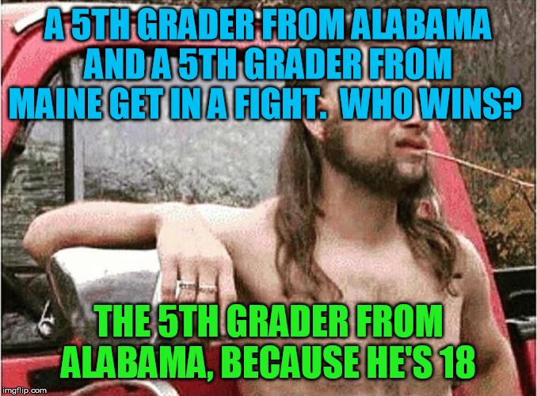
Tactics
Hate and Dog Whistles
Attacks based on identity and stereotypes can often be subtle and coded.
Notes:
This meme is framed as "just a joke," and doesn't use offensive language or make any factual claims that anyone would take seriously.
So, how does this contribute to misinformation?
Messages like this are designed to reinforce our divisions based on stereotypes of another group's intelligence or character. They make it almost impossible to have an issue-based discussion.
In a way, they are versions of the "ad hominem" and "straw man" arguments - both forms of faulty logic. In an ad hominem argument, you attack the person you're arguing with instead of addressing their argument. A "straw man" argument sets up a flimsy or ridiculous version of an opponent's position and then knocks it down. Hate and stereotyping add to misinformation by mocking targeted groups, and then dismissing or misrepresenting their positions.

Slide 14
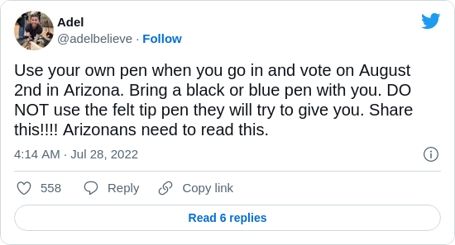
Tactics
Conspiracy Theories
Innuendo is a powerful vehicle for amplifying paranoia and fear.
Conspiracy theories often deliver or imply extraordinary explanations for mundane situations.
Notes:
This message sounds like a helpful tip to voters to use their own blue or black pen, rather than the pens available at the polls. Many people may pass along a message like this thinking "better safe than sorry." So, how is this misinformation harmful?
Conspiracy theories are harmful because they break down trust in our usual information sources - often to clear a path for misinformation to spread easily. They often use questioning and innuendo to raise doubts. Conspiracy theories often:
Blame certain politicians, organizations, or wealthy & powerful people for a problem
suggest that there is hidden information that "they don't want you to know"
imply sinister motives, like cheating, greed or power, for keeping the information secret
thrive when there is not clear information available to explain a situation
When we think about conspiracy theories, we usually imagine the complicated theories that sound obviously crazy to us, but some - like the one in our example - are simpler and more believable, and circulate all the time. Any time you run across signs of conspiracy theories, be skeptical and evaluate the idea carefully.

Slide 15
Tactics
Old and Out of Date
Old content is often hard to recognize when reshared on social media.
Notes:
Social media makes it really easy to confuse something recent with something out of date. It is natural for viewers to assume a posted news story is current, and “shared” articles often don’t display the publication date. In this case, a news article from 2012 about voters in Florida was reshared days after the 2018 midterms. The story was from a reputable source, and likely true at the time and in the original context. In this example, it even displayed the original date. However when it was shared six years later in the context of a contentious recount fight in Florida, anyone skimming their newsfeed could easily be left with the impression this story was contemporary. Checking the date when something was originally published is incredibly easy and a good habit to develop, especially when the substance is inflammatory.
Next, Eileen will take a look at some of the reasons misinformation works so well.

Slide 16
UNDERSTANDING THE APPEAL: What makes disinformation stick?
Notes:
Why do misleading messages work on us? There are many reasons, but some of the most potent explanations can be useful as we think about how to recognize misinformation when it appears in the wild. By learning how we are manipulated, we can develop our own resistance to the manipulation. There are three concepts we’ll explore here: motivated reasoning, emotional appeals, and easy answers.

Slide 17
What Makes Disinformation Stick
Motivated Reasoning
Content that reinforces our existing bias is easier to believe and accept as true.
Notes:
We are predisposed to believe ideas that align with our political beliefs and social values. When we learn that someone we don’t trust or agree with may have done something bad, we are less likely to question the evidence because we already expect them to be guilty.
These biases can also get us into trouble because they condition us to rationalize or ignore things which don’t align with our views.
When we evaluate what we’re reading and hearing, we need to pay particular attention to whether or not a message plays to these biases as we look for and judge the evidence to support the idea. Just because we want something to be true doesn’t mean it is.

Slide 18
What Makes Disinformation Stick
Emotional Appeals
Content that appeals to our emotions rather than reason triggers our reflexes and we can jump to conclusions not supported by facts
Notes:
Misleading messages often strike an emotional chord with us. Usually they make us angry or fearful, but sometimes they also might make us happy or proud. Any time we encounter a message that triggers a strong emotional response, we have to take a step back and consider why the message makes us feel that way, and if those emotions risk clouding our critical thinking.
The most effective disinformation campaigns trigger powerful emotions that logic can be difficult to overcome.

Slide 19
What Makes Disinformation Stick
Easy
Answers
Big and confusing problems that are explained with easy answers offer us a shortcut that bypasses our critical thinking skills.
Notes:
As we discussed earlier, conspiracy theories frequently offer easy answers to difficult questions. Many types of misleading messages rely on easy answers to get you to jump straight to a particular conclusion. Whether it is about your pocket book or misinformation, the same advice applies: “if it seems too good to be true it probably is.”

Slide 20
What makes disinformation stick?
Motivated Reasoning
Emotional Appeals
Easy Answers
Often these appear in the same message
Notes:
Frequently a message can use two or three of these strategies at the same time. An emotional appeal can be made to make an easy answer easier to digest. Motivated reasoning can be potent because it also deals with a topic that makes you angry. These are features you will begin to notice appear in many of the misleading messages you encounter.

Slide 21
UNDERSTANDING MOTIVATION: Why do people create disinformation?
Political Agenda
Profit
Pride and Pranks
Some bad actors produce and spread falsehoods and deploy misleading tactics to persuade people.
Many disinformation creators exploit the virality of messages to generate revenue from ads and ecommerce.
Hate and conspiracies are often invented and promoted by trolls who seek attention and thrive on chaos but don't care about the substance of their lies.
Notes:
The last piece of the landscape we’ll look at is the motivation of those who create and purposefully amplify disinformation. Sometimes it’s hard to determine a motive behind the misinformation you see, but in some cases it is clear. Looking for obvious motives can be helpful in identifying campaigns of deception and overt efforts to mislead.
When discussing misinformation with others, it is helpful to bring up the motives of the content creators, because it highlights for them how they might be getting manipulated or exploited. It also encourages them to engage and defend themselves. (It is important to focus on the original creator of the message, and not question the motives of the people in conversation with you.)
Many bad actors are driven by a political agenda. They spread falsehoods and use the various tactics we have discussed earlier in service of a mission to achieve policy and electoral goals. Electing candidates, passing laws, and shifting public opinion towards the causes they support is their primary objective. We generally assume this is the dominant motive in the corrosive content we observe.
However, a large proportion of disinformation is actually driven by profit. We often see these messages appear in support of direct funding appeals, product sales, and even efforts to drive traffic to generate advertising revenue. The revenue generated from spreading disinformation continues to grow and diversify.
Finally a subset of bad actors are “trolls” who are motivated by the enjoyment they derive from generating disinformation. Trolls are chaos agents who take pleasure in spreading conspiracies and hate simply because it gives them attention and offers an outlet for their frustration.
As we look to recognize the various forms of mis- and disinformation that get shared online, it is important to look for clues that might help us to recognize the motivations of the disinformers as well. Understanding those motivations is a valuable way to inoculate against and respond to problematic content.

Slide 22
Recapping the Problem
It comes in many forms
It lives in the gray area between truth and lies
It appeals to our biases, emotions, and desire for easy answers
Politics, profit, and pranks motivate its creation
If we are not careful we can accidentally contribute to the spread
Notes:
Before we move on to responsible engagement, let’s briefly recap what we have covered so far.
This problem comes in many forms and deploys many distinct tactics. What we see frequently lives in the gray area between truth and lies, and sticks because it plays to our biases, emotions and desire for easy answers. When it is spread by bad actors, they are motivated by politics, profit, and the thrill of pranks.
Let’s add one final piece of this problem: we can become part of it if we are not careful.

Slide 23
Strategies for Action
First rule: DO NOT ENGAGE
When to consider engaging
Counter messaging strategies
Structured conversations
Notes:
Now that we have a clear understanding of the landscape and a detailed overview of what the problem looks like and why it exists, let’s start to think about what we can do about it.
We’ll start by talking about disengaging. A critical rule is in almost all circumstances is that you should NOT engage with mis and disinformation or the people who create and amplify it. We’ll go through a range of ways to think about how and why you should not engage.
Then, we’ll talk about the exceptions, the circumstance when we may want to carefully consider some kind of engagement.
From there we’ll talk about the specific ways to think about effectively and responsibly messaging when you need to.
Then we will conclude this section by talking about how to use structured conversations to think about more meaningful ways to build bridges with people who believe and share misinformation.

Slide 24
When in doubt:
DO NOT ENGAGE
Notes:
The first and most important guideline to consider when you find any kind of problematic content, on or offline, is that you should not engage. The risks and downsides far outweigh any perceived benefits. There may be a personal toll if there is backlash against you, or unpredictable social consequences. And critically, your effort to respond can have the opposite of the intended effect and increase the reach and potency of the falsehood you’re trying to address.

Slide 25
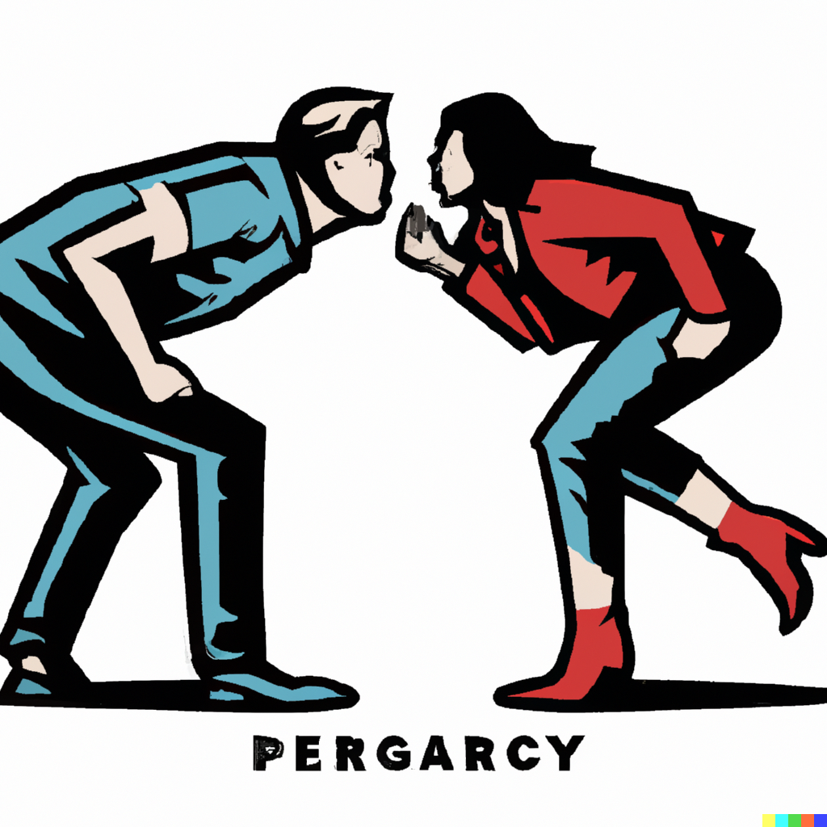
Don't argue
Creating a defensive posture pushes someone deeper into their corner and makes it harder to communicate
Notes:
If you do engage, you want to avoid some common mistakes we all naturally have a tendency to make. You do not want to argue. When you argue directly with someone and try to contradict them, they usually respond defensively and get pushed deeper into their own corner and more fiercely defend the fallacy. Unfortunately, this can actually increase their belief in a misleading concept. In a heated argument, your disagreement can even be seen (or felt) as evidence in favor of the rumor they believe.

Slide 26
Don't amplify
Commenting, sharing, or hitting dislike online only serves to further promote the misleading content.
Notes:
Online, any form of interaction with a falsehood can serve to amplify it. The algorithms that choose which social media content to feed to people don’t always care whether a post is getting positive or negative engagement. Some algorithms even favor negative engagement! They take any form of viewing, commenting, and resharing as a signal that they should boost the reach of a piece of mis- or disinformation. The last thing you want to do is help more people see something that they wouldn’t have otherwise when you were trying to squash or debunk it. Unfortunately people often become unintentional spreaders of misinformation even when they are trying to do something good.

Slide 27
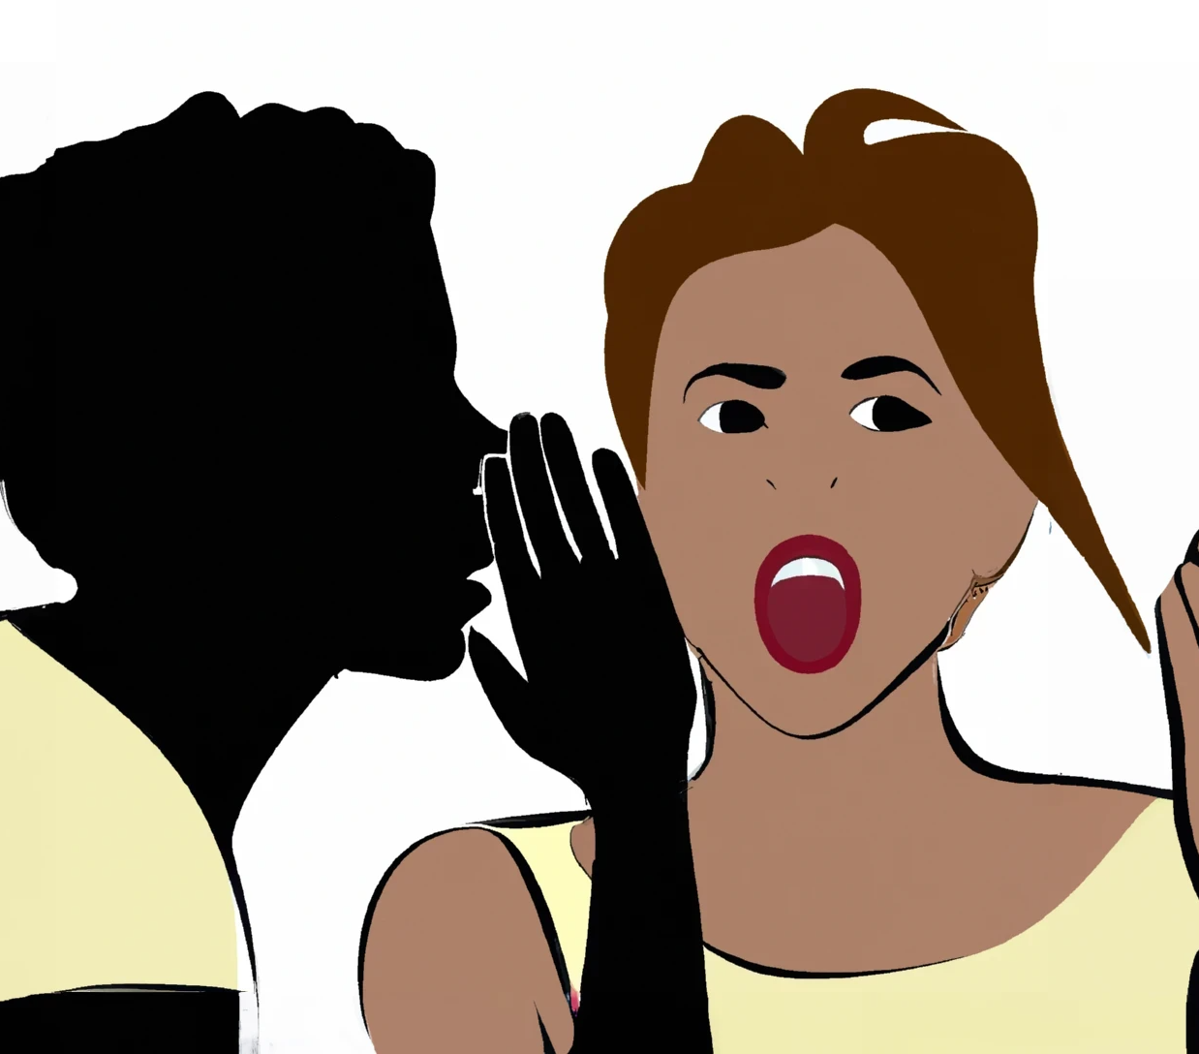
Don't repeat the language of the falsehood
Language has power, and we shouldn't cede that power by using the terminology created by disinformers.
Notes:
When you try to talk about misleading ideas, disinformation, or conspiracy theories, it is hard to avoid using the language of the people who created them. But, it is critical to prevent disinformers from defining the terms of a debate. When a debate occurs, using the disinformers’ wording allows them to control the terms of the conversation. This is especially important when it comes to the terminology used around the safety and integrity of our elections. You should not repeat the language used by those who seek to undermine the legitimacy of the democratic process. Their effort to define and repeat the terminology is also an effort to normalize the misleading and harmful ideas.
The recent reporting on mis-dated envelopes for mail-in ballots in Pennsylvania is a good example. When a voter forgets to date the outer envelope, or accidentally writes in the wrong year, should this really be called an “illegal mail-in ballot?” Or is it a ballot with “errors on the envelope?” Agreeing to call clerical and typographical mistakes “illegal” changes the discussion before it even starts.

Slide 28
Don't embarrass
Ridiculing someone, especially with derogatory language won't result in a positive or receptive response.
Notes:
When you interact with someone in real life or online, you need to be very careful to avoid using words or tactics that might embarrass or ridicule them. Similar to arguing, this usually has the opposite of the intended effect. While you may be frustrated or even shocked that someone else might believe something you feel is “absurd” or “stupid” you cannot convince them otherwise by making them feel bad, and instead your effort is more likely to backfile and reinforce their beliefs, and make you an enemy at the same time.

Slide 29
Don't contradict with ONLY a fact-check
Fact-checks are important, but when you share them without context or more discussion, they can reinforce distrust in the source.
Notes:
It is common, and seems like “common sense” to respond to misinformation by sharing a fact-check. Fact checks and the people that produce them are a critical piece of the effort to counteract and build resilience to mis and disinformation. But some ways of using fact checking sources are more effective than others. Unfortunately, many of the same people who believe or post misinformation are already skeptical of the organizations that produce fact-checks, and simply dismiss them as biased. This is yet another case where the fact-check can actually serve as evidence to some that the falsehood they believe is true. From their perspective, if you are relying on an untrustworthy or biased source, that is another strike against your argument, and a point in favor of their belief.
Responding with just a fact check can also come across as condescending. It’s like saying, “You should have looked it up!” It is more effective to read the fact-check, and think about what it teaches you about the motivations and gaps in knowledge that are exposed by a piece of misinformation. Then you can use this knowledge, or the original sources mentioned on the fact-checking site, to help you communicate positively about the topic in a way that educates rather than demeans.

Slide 30
Response Strategies
WARNING: Before responding, think carefully about the risks and be sure you have a plan to proceed. When in doubt, DO NOT ENGAGE.
Notes:
This may seem redundant at this point but it cannot be stated enough. Before you consider how to respond, you should always consider IF you should respond. If you are in doubt about the risks, the answer is always DO NOT ENGAGE. DO NOT RESPOND.
Now Eileen will explain When & How you can engage effectively.

Slide 31
When SHOULD you consider engaging?
TIPPING POINT
When a misleading narrative has crossed a tipping point – and demands response (this varies widely depending on your community and audience) but requires good judgement
KNOWLEDGE GAP
When misinformation exposes a clear data deficit that can be filled with good information so that the people you reach aren’t susceptible to the falsehood because they already have good information to fill the gap.
RESOLVE OBSTACLES
When you are directly engaging with people where the misleading information creates a practical obstacle to moving forward.
Notes:
Before we talk about how to actually engage responsibly, we need to think about what circumstances make it appropriate to consider attempting to respond.
There are a few types of situations where it is helpful to engage.
When a rumor, conspiracy theory, or other type of misinformation has already become widely known and discussed throughout the community, that idea may cross a tipping point where the benefit of addressing the issue outweighs the potential harm. Basically, the tipping point comes once It is too late to prevent the message from spreading further. Deciding when misinformation has reached a tipping point is subjective, but once misinformation is already circulating widely on multiple social media platforms, generating news coverage, or is being discussed frequently within a community, it probably deserves a response.
Sometimes, a particular piece of misinformation pops up to fill a gap in information or “knowledge gap.” This often occurs when there is legitimate demand for information on a subject but you can only find low quality information when you search for it. If you can identify a knowledge gap exposed by problematic content, then that represents a good candidate for response. The goal here is to fill that deficit with good information rather than repeating the falsehood, which is both safer, and more productive. A good example of a knowledge gap occurred during the 2020 elections when Pennsylvania introduced mail-in voting and new voting machines. People looking for information on how to participate in the 2020 election found a wide variety of misinformation. Some represented honest mistakes from their fellow confused citizens, but the knowledge gap also left plenty of room for bad actors to spread disinformation. The LWV responded to this knowledge gap with voter education across several media platforms.
In some cases, you may find yourself in a situation where misinformation creates a concrete obstacle in the real world. Registering voters or participating in the voting process are obvious examples. In these situations, a falsehood may need to be addressed in the moment to actually overcome that obstacle. In these circumstances it is critical to recall the guidance about how NOT to engage. Particularly the advice about avoiding arguments and embarrassing others. Structured conversations, which we’ll talk about in a moment can be particularly useful in these situations.

Slide 32
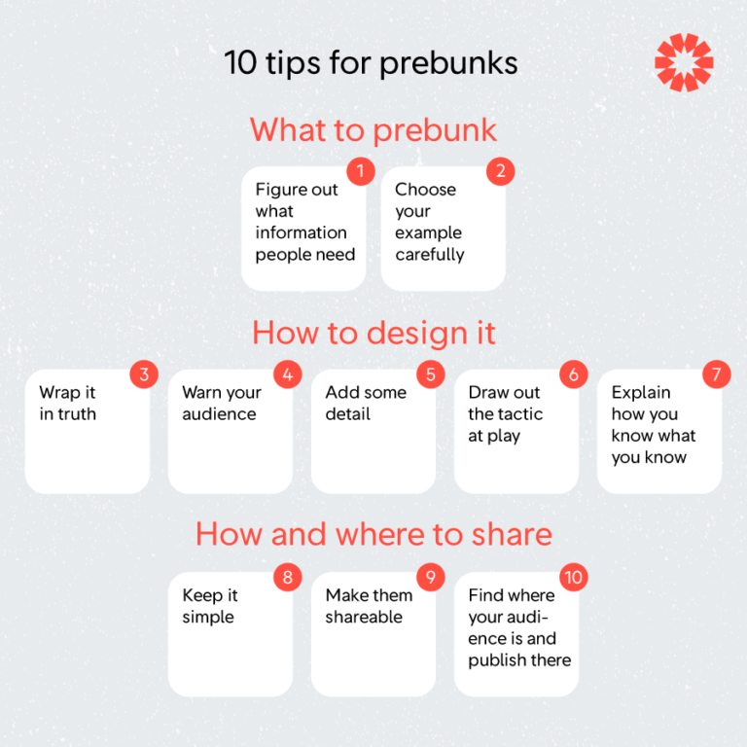
Counter Messaging
Prebunking as Inoculation:
Getting ahead of rumors by exposing misinformation risks so that people are immune to them when they appear in the wild.
Source: First Draft Guide to Prebunking
Notes:
Spoiler Alert! The following strategies require preparation and thought, rather than being off the cuff.
“Prebunking” has become a key strategy to combat misinformation. A pre-bunk is a message designed to inoculate someone against a particular misinformation narrative or tactic so that they are more resilient to it, much in the same way that a vaccine inoculates us against a virus.
Helping people develop this immunity to misinformation requires carefully identifying, crafting, and communicating a message that can effectively pre-bunk a bad idea without the risk of amplifying it.
This set of tips originally designed for journalists is a useful checklist to follow when you want to embark on pre-bunking as a counter messaging strategy.
Start by figuring out what the data deficit is you want to tackle and carefully choose an example that is easy and safe to communicate.
Build your message by starting with the truth, make sure to warn the audience that you’re going to talk about a falsehood, provide some detail to explain the actual problem you’re tackling, describe the tactic used to mislead, and close the message by restating the true information bolstered by evidence to justify how you know what you know.
Make your message simple and shareable and make it available where the people impacted are likely to see it.
This is the strategy we used when we created the video “Journey of an Official Election Ballot”, in order to fully explain and prebunk what happens before, during, and after a voter completes a ballot.. This popular video can be found on our “Explainers and Graphics” web page, along with ALL of the other educational resources and web pages we have created at www.lwvpgh.org.

Slide 33
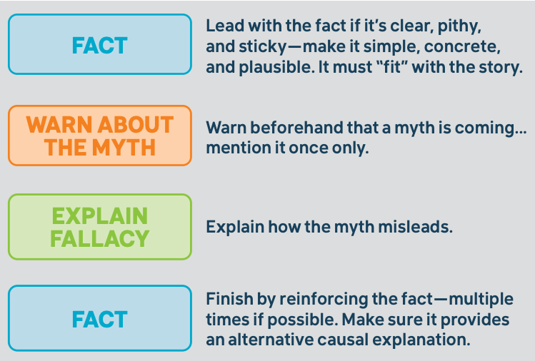
Counter Messaging
Source: Debunking Handbook 2020
Notes:
When the right criteria have been met for engaging in counter messaging and you have a specific problem you need to address. This structure for a message can be a useful way to think about designing that communication. It mirrors the tips we just outlined and follows a basic structure. Begin and end your message with facts, be sure to warn the audience before you describe the problem, and make sure to explain how the message is misleading by describing the tactics it uses, the reasons why it is persuasive, and if possible, explain the motives of those who created it.

Slide 34
Structured Conversations
Ask Questions
Show Empathy
Explore Motives
Share Perspective
Explore what the other person believes, why it is important to them, and how this translates into their concerns
Establish shared values to build upon and communicate respect for their beliefs and fears
Discuss the underlying motivations behind the actors at the source of misleading messages
Share your personal experience and explain how you came to your own conclusions
Notes:
When circumstances permit, active and structured conversations can be a valuable approach to addressing misinformation within your community. Particularly when there is more time and possibly the opportunity to engage face to face.
A meaningful structured conversation starts with openness and a sincere effort to understand someone else’s perspective.
Begin by asking questions that help you learn what someone else believes and why those beliefs are important to them.
Be sure to show trust and empathy so that you can establish the shared values you have and your honest desire to understand the fears someone else has.
As you delve into the specifics, maintain a focus on the motives of those who created the messages in question rather than the person you’re speaking with so that you are not alienating them.
Be sure to share your own perspective in a way that describes your personal experience, how you learned what you learned, and why you find it meaningful.
This structured conversation strategy builds on all of the advice we have reviewed in this counter messaging section. Effective structured conversations avoid arguments and demeaning language. They don’t rely solely on the authority of outside voices like news organizations or fact-checkers, and instead build on personal experience.
This approach can be complicated and doesn’t always work in the moment, but when you demonstrate respect and empathy as you communicate you are more likely to build trust that will have a lasting impact.
Do not advance slide – Insert roleplay of Structured Conversation.

Slide 35
VOLUNTEER REPORTING: Civic Listening Corps
Notes:
The last portion of our training is about what you can do as soon as TODAY to help build resilience to misinformation for yourself, and contribute to your community. Effectively spotting mis- and disinformation when you see it online or in your community is a skill that requires practice. Learning to do it quickly and accurately takes time and effort. The League of Women Voters has partnered with the Algorithmic Transparency Institute on a program called the Civic Listening Corps to give you the opportunity to find and report problematic content when you see it so that you can exercise these new skills and so that you can benefit broader efforts to combat misinformation across the country.

Slide 36
Recognizing and Reporting
Train
Learn to recognize common forms of misinformation.
Listen
Observe the discourse online and offline within your community
Report
Identify problematic content, flag and annotate it
Notes:
The Civic Listening Corps Program continues the training you have begun today by going into greater detail on the common forms and tactics used to spread misinformation.
This volunteer program operates on a shift-based model where you sign up to commit one or more hours to dedicate to the task of listening to the discourse in your own social media feeds or elsewhere online to find instances of problematic content that are circulating.
You then flag that content and submit it to a shared repository and describe the problem you identified with it.

Slide 37
The Benefits of Civic Listening
Resilience - Learning to recognize misinformation helps you build up immunity to future versions. You become an anti-disinformation antibody ensuring the long-term health of the discourse within your community.
Situational Awareness - a broad, diverse, and representative understanding of the narratives impacting communities ensures coordinated action can be targeted, and insights can be shared across geographies.
Accountability - Patterns can be identified to enable investigative reporting, research, litigation, and regulation that will hold bad actors and platforms accountable.
Notes:
Over time, by participating in this process you can help achieve multiple goals at once.
For yourself and your community, the act of finding and flagging problematic content helps you build the resilience we seek directly. You learn to recognize common types of messages and gain an awareness of the most recent and popular strategies used to mislead people. This makes you less susceptible yourself, and it arms you with knowledge and personal experience that you can use to communicate with others to share your resilience.
At the same time you will benefit the broader community of organizations working together to combat mis and disinformation by sharing what you see locally with others all across the country to establish a foundation of situational awareness that can support communications and inoculation messaging.
Finally, by comprehensively identifying and documenting the problems we encounter, we identify and take action based on the patterns that are identified. Bad actors can be exposed and the social media platforms that enable them to amplify falsehoods can be held accountable.
Participating in the Civic Listening Corps gives you the opportunity to participate in realizing the vision of a “whole of society response” to combating mis- and disinformation.

Slide 38
Start Today
SMS
WhatsApp
Email
Web
+1 859 374 8741
+1 202 301 8788 lwv@tips.junkipedia.org
www.junkipedia.org/tips/lwv
Join the League effort at the Civic Listening Corps:
tinyurl.com/lwvciviclistening
Notes:
There are two ways you can start to participate TODAY.
First, you can take out your mobile phone right now, open the camera app, and point it at this QR code. When you scan it, your device will ask you if you would like to add the League of Women Voters Tiplines to your address book. If you do so, you will essentially bookmark these contacts on your device. Then, the next time you encounter something problematic online you will have an instant means for flagging that content into this shared repository. As you scroll through any social media app, you can choose to click the “share” button for something you found online that looks problematic. But instead of amplifying it within the platform you can share it via SMS to this tipline you just added to your device so that our community is made aware of it.
The second way you can participate is by signing up to join the League’s effort at the Civic Listening Corps. Visit this link in your browser or phone and confirm your interest and you’ll be invited to the next Civic Listening Corp training and get updates on listening shifts that you can sign up for.
https://tinyurl.com/lwvciviclistening
By actively participating in this process you can help the League understand and combat the misinformation that is affecting your community, and likely other communities as well.

Slide 39
Resources from “Building Resilience to Mis- and Disinformation” (LWVUS)
League of Women Voters: Misinformation Guide
Office of the US Surgeon General: Misinformation Toolkit
Union of Concerned Scientists: Countering Disinformation in Your Community
George Mason University: Debunking Handbook 2020
News Literacy Project
Cambridge University / Jigsaw: Prebunking Training Videos
Additional Resources (LWVPGH)
League of Women Voters of Greater Pittsburgh Website: www.lwvpgh.org/disinfo
What To Know About Bots
Bringing Conversation Back to Common Ground
Civic Listening Corps: tinyurl.com/lwvciviclistening
Notes:
These are some of the resources that were used to create this presentation. Many of them are also available on our website at www.lwvpgh.org/disinfo
You can view a previously recorded version of this presentation on the webpage. A slide deck is also available for downloading.

Slide 40
Thank you!
League of Women Voters of Greater Pittsburgh info@lwvpgh.org www.lwvpgh.org

